Slide 1
Provider Meeting March 14, 2024
1:00PM-3:00PM
Quality and Community Outreach Department

Slide 2
DSP of the Month
Amanda Whitcomb
Brenda Nyers
Kristy Bates
Exceptional !
Notes:
DSP of the month winners
Brenda Nyers Active Day Nominated by Beth Cheney
Amanda Whitcomb- Achieving Dreams Nominated by Raymil Norton
…

Slide 3
County Board Updates
Team Process & Service Provisions
ISP Notifications
Daylight Savings
Competency Based Rate Add on
Rule Update Email
Eclipse- Safety
Resource Fair- Save the Date
Free Choice of Provider Postings
Trainings Available

Slide 4
Team Process
TEAM-means as applicable
The group of persons chosen by an individual with the core responsibility to support the individual in directing development of his or her individual service plan. The team includes the individual’s guardian or adult whom the individual has identified, as applicable, the service and support administrator, direct support staff, providers, licensed certified professionals, and any other persons chosen by the individual to help the individual consider possibilities and make decisions 5123-17-02 (24)(a)

Slide 5
Team Process
Person
Parent/Guardian/Advocate
Provider
ALL Others
QIDP/SSA
Notes:
Team process will look different for everyone. Teams role is to ensure that what the person wants happens.
Each member of the team will experience a different view or version of the individual that you are supporting. IF we are not hearing everyone that is on the teams feedback we could be limiting what the individual will be able to accomplish.
The team process is continuous and the planning does not end when the plan is finalized. The hope in the OHIOISP is to make a movement from a life filled with SERVICES to a Valued life.
Person- Identify what they need, what they think should happen. And share with the SSA or QIDP when something is not working.
QIDP/SSA- This role should be organizing the information and driving the ongoing conversations with the team. SSA/QIDP should be digging deeper and work with the team to make what the individual wants happen. Completes and maintains the documentation. Making sure all the voice are heard. Facilitate difficult conversations (being an outside neutral party) Team members should not identify other team members as difficult Focus on the difficult situation and how to work through that. Plans should clearly Identify what providers are being paid to provide, DSP’s should know exactly what they are expected to do, and parents and guardians should know exactly what to expect will happen. And finally SSA/QIDPS are responsible for monitoring (are the plans being implemented as written? This should not occur 1 time a year but throughout the year) Through tech, phone calls, coffee with the individual, casual dropins)
Parent/Guardian/Advocate- Responsible for helping identify what is working and what is not working. Identify concerns or changes for that individual.
Provider- Responsible for

Slide 6
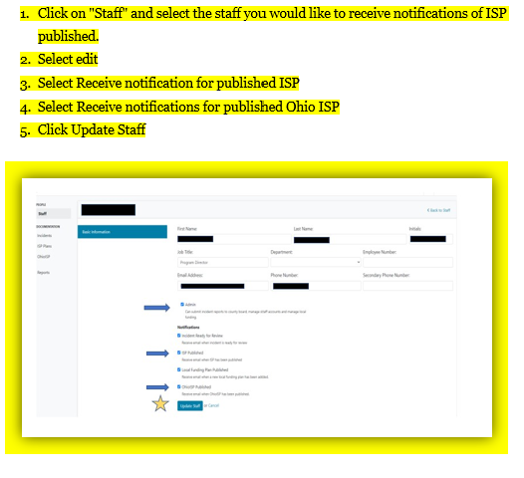
EFFECTIVE March 1, 2024- ISP’s will no longer be mailed to providers
Notes:
Reminder when viewing the ISPS the SSA’s are being held to a REVIEW date that the SSA will reach out to providers to ensure that all of your staff have been trained on the new ISP. Please help SSA meet this deadline by sharing with them requested documents.
BY rule providers should have all documents reviewed by staff and signed off anytime there is a new Isp in place.

Slide 7
Reminder
The time change in March has implications for your billing.
Daylight Savings Time begins Sunday, March 10, 2024, at 2:00 a.m. (We “spring forward” one hour.)
So you can only bill for 23 hours--or 92 units--for Homemaker Personal Care (HPC) on March 10.
This includes routine HPC, as well as On-Site On-Call and Adult Daily Living (MRC).
Notes:
A.

Slide 8
Competency Rate Add-on
Reimbursement rate per unit is increased by $.39
DSP rate $1.00 more per hour
Provider reimbursement $1.56 per hour
Two yeas experience
Completion of 60 hours applicable training
Courses must have been completed within five consecutive calendar years of the application for the add-on.
Notes:
An add-on rate is an amount “added-on” to the regular rate of reimbursement available for certain services. The Competency-Based Training and Longevity Add-On adds $0.39 per 15-minute unit to the regular reimbursement rate for routine homemaker/personal care, or Homemaker/Personal Care (HPC) services.
Direct support professionals (DSPs) interested in obtaining the add-on rate must meet the following conditions to be eligible:
• Two years of paid, full-time or equivalent experience providing support to people with developmental disabilities. More on experience required.
• Completion of 60 hours of applicable training. More on applicable training.
Applicable Services The add-on is only applied when eligible DSPs provide routine HPC. The add-on does not apply to On-site/On-call, participant-directed HPC, or any service other than routine HPC.
Two Years of Full-Time Experience To be eligible for this add-on, DSPs must have two years (or the equivalent 4,160 hours) of experience providing hands-on support to people with developmental disabilities. That is 4,160 hours of paid work, providing services authorized through Level One, SELF, or Individual Options waivers (see a full list of waiver services), providing services in an intermediate care facility for individuals with intellectual disabilities, better known as an ICF 1, or providing services funded by local resources, such as county board-funded programs like supported living or respite. These hours do not have to be consecutive, nor do they need to be from the same agency or job. Hours can be part-time, intermittent, seasonal, or occasional work over any period. Hours of experience may include hours worked in other states.
Employees of a provider agency must submit proof of training to their employer, in a manner prescribed by the employer, before the add-on can be applied. 3 Revision June 28, 2018, to add an agency provider-specific Employment Experience form. 6 Once the agency has verified the information, the agency may bill for hours of Homemaker/Personal Care or HPC services provided by an eligible DSP using a billing code that reimburses the agency at a higher rate
The agency is required to maintain verification of related experience and training for each DSP for whom the add-on is billed.

Slide 9
An Update from the Ohio Department of Medicaid
Proposed Individual Options renewal and amendments for Level One and SELF waivers posted for public comment
Greetings,
The Ohio Department of Medicaid’s Home and Community-Based Services Policy Section is seeking public comment on the renewal package for the Individual Options waiver program and proposed amendments to the Level One and SELF waiver programs prior to submission to the Centers for Medicare and Medicaid Services (CMS) for review. A 30-day public comment period on the proposed amendments and renewal will run from March 1, 2024, through March 30, 2024.
Thank you in advance for your review. ODM looks forward to receiving your feedback on the following proposed renewal and amendments.
Public Notices (ohio.gov)
Comment Here
9
Notes:
This email went out last week reminding providers to report any comments on the open rule proposed changes. The proposed changes may have caused som confusion.

Slide 10
DSP 2023 Compensation Survey Training
3 course will be offered
April 9, 11AM-12PM Adult Day Array Providers
Course for Adult Day Array Providers: Tuesday, April 9, 11 AM - 12 PM
April 10, 2-3PM Introductory Course for Homemaker Personal Care providers
Introductory Course for Homemaker/Personal Care Providers: Wednesday, April 10, 2 PM - 3 PM
April 15, 12PM-1PM, Refresher Course for Homemaker personal Care providers
Refresher Course for Homemaker/Personal Care Providers: Monday, April 15, 12 PM - 1 PM
Notes:
Register for 2023 DSP Compensation Survey Training
Attention: Agency providers that billed for Homemaker/Personal Care and/or Adult Day Array Services in calendar year 2023
The 2023 DSP Compensation Survey is quickly approaching, with an expected release date of April 15 and close date of June 30. The purpose of the annual DODD Direct Support Professional (DSP) Compensation Survey is to determine how provider agencies use Medicaid service rate increases to support the direct care workforce. Section 751.20 of House Bill 33 now requires annual reporting of direct care worker wages to the Ohio General Assembly, the Governor, and the Joint Medicaid Oversight Committee.
DODD will offer three training sessions to help providers meet compliance requirements:
Course for Adult Day Array Providers: Tuesday, April 9, 11 AM - 12 PM
This 1-hour course is designed for providers who offer adult day array services (i.e., adult day services, vocational habilitation, employment supports, career planning) who will be completing the DSP Compensation Survey. We will review the revised 2023 survey, demonstrate the guidance materials, and answer questions about accurately reporting compensation, turnover, and tenure. This session will be recorded for people who are unable to attend.
Introductory Course for Homemaker/Personal Care Providers: Wednesday, April 10, 2 PM - 3 PM
This 1-hour course is designed for providers of homemaker/personal care services who will be completing the DSP Compensation Survey for the first time. We will review the revised 2023 survey, demonstrate the guidance materials, and answer questions about accurately reporting compensation, turnover, and tenure. This session will be recorded for people who are unable to attend.
Refresher Course for Homemaker/Personal Care Providers: Monday, April 15, 12 PM - 1 PM
This 1-hour course is designed for providers of homemaker/personal care services who have experience completing the DSP Compensation Survey. We will review the revised 2023 survey, demonstrate the guidance materials, and answer questions about accurately reporting compensation, turnover, and tenure. This session will be recorded for people who are unable to attend.
Please contact DSPComp@dodd.ohio.gov with any questions

Slide 11
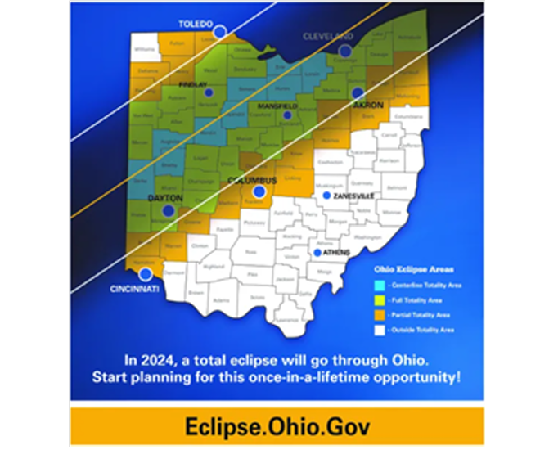
Heavy Tourist Traffic
Adequate Food supplies in the home
If traveling allow time to get to your destination
Prepare for cell and internet interruptions
11
Notes:
hat to Expect On the day of the eclipse, many communities in the path of the eclipse will see heavy tourist traffic. We encourage people to view the eclipse from open spaces closer to home if possible. If you do decide to view the eclipse in your community, be sure to plan ahead: • We expect heavy traffic and long waits on local roadways that day. Please be patient and courteous while driving. • Consider carpooling, and try to have plenty of gas or charge for your vehicle if you plan to drive. • Bring plenty of food and water. DSPs should consider the following if they are supporting someone on the day of the eclipse: • Considering rescheduling any unnecessary appointments that day (please refer to the advise of healthcare professionals for medical appointments). • Check with the person’s place of employment or day program to see if they will be open that day and ensure necessary supports are in place if the person will not be at work or day program. • Ensure adequate food supplies in the home. • Ensure adequate medications for the day. • Be prepared for Internet and cell phone interruptions. • Anticipate scheduling needs (ie; shift change during the time of eclipse). • Contact local EMA if you have questions - Ohio EMA Directory. Ohio Department of Developmental Disabilities • 30 E. Broad Street • Columbus, OH 43215 • (800) 617-6733 • dod

Slide 12
Save The Date
June 13, 2024
2nd Annual Resource Fair

Slide 13
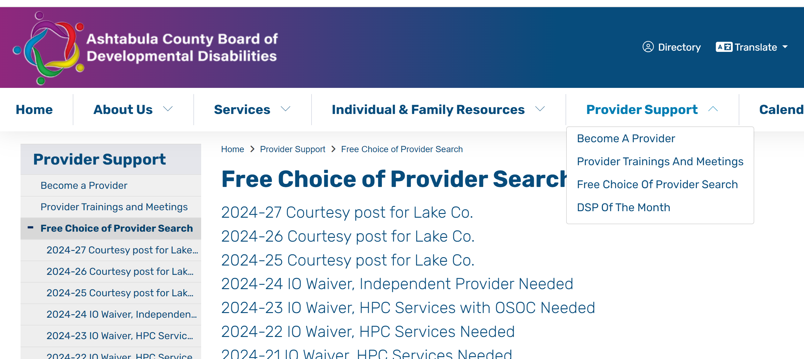
Free Choice of Provider

Slide 14
Community Inclusion activities
14

Slide 15
And So Much More!
Notes:
Camp Koinonia Grant Opportunities
Through grant funding, the Ashtabula County Board of DD can send 10 people to three different camps at Camp Koinonia this year! To request funding for registration, complete the signup using the links below.
The Ashtabula County Board of DD has a committee that will help determine who has been selected to receive this funding. Filling out these forms does not mean you will receive funding. Grant recipients will be notified by April 1st.

Slide 17
QUESTIONS?

Slide 18
Thank You!
Next Provider Meeting
April 11, 2024

