Slide 1
Provider Meeting
August 15, 2024
1:00PM-3:00PM

Slide 3
DSP of the Month
Sierra Sipe
Lynn Minor
Cierra Orser
Notes:
Lynn Minor Independent Provider Nominated by Miriah Kister and Holly Bowser
Holly-Lynne has been a wonderful addition to our family. She is always on time and ready with a smile to help Hannah have the best day possible. Lynne is flexible and works with Hannah to make decisions about daily activities. Lynne has taken Hannah to the water park and been entirely drenched. It is refreshing to see Lynne be willing to do whatever Hannah needs and she does this all with a great, positive attitude. Miriah- Lynne is so wonderful with Hannah. She has helped Hannah access the community, learn new skills and feel more independent. Hannah is so exited when she has her time with Lynne. They have build a great relationship together. Lynne has become like family to Hannah and her family. We are so grateful she has come into Hannah life and we are excited to see the amazing things in the future she helps Hannah with. Thank you so much Lynne and you are rock star.
Sierra Sipe- Vitality Supported Living Nominated by Miriah Kister
Sierra is an absolutely amazing person. She always goes above and beyond for her Clients. She has been with Will for 5 years and is always there to help with what is needed. She is always willing to help with anything going on with Will. She stepped up and was willing to work with Will at home and in the adult day program so he could return to the adult day. She is always helping the family and the SSA to ensure he has the best life and care he can. I am so grateful for her and all the hard work she does. She is so caring and hard working. Will and his family would be lost with out her. Thank you so much, Sierra.
Cierra Orser- Brighter Horizons- Nominated by Meranda Myers
Ciera works mostly with one of our most challenging duel diagnosis individuals. This individual historically has 1 or 2 psych admissions per year, but for the last 3 years, since she has been working with him so extensively, he has learned a variety of new coping mechanisms that she and her unique brand of humor have helped him master, and he hasn't had a hospitalization in a couple years. It's rare to see such a marked improvement in an individual that is so obviously related to a single member of their team, but Ciera has forged a special line of communication with this person, and has made a huge difference in his life.

Slide 4
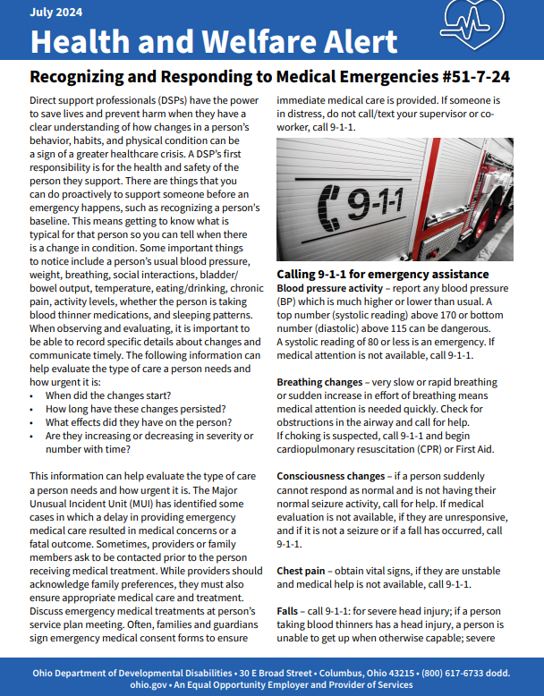
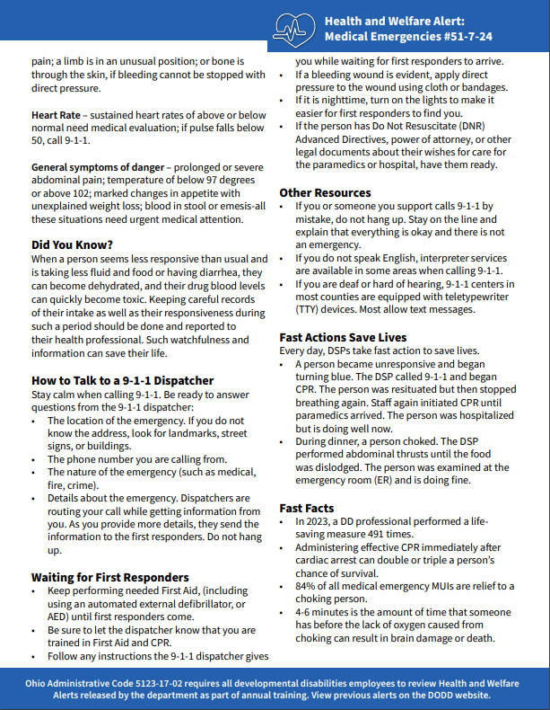
ISS Department
Health And Safety Alerts

Slide 5
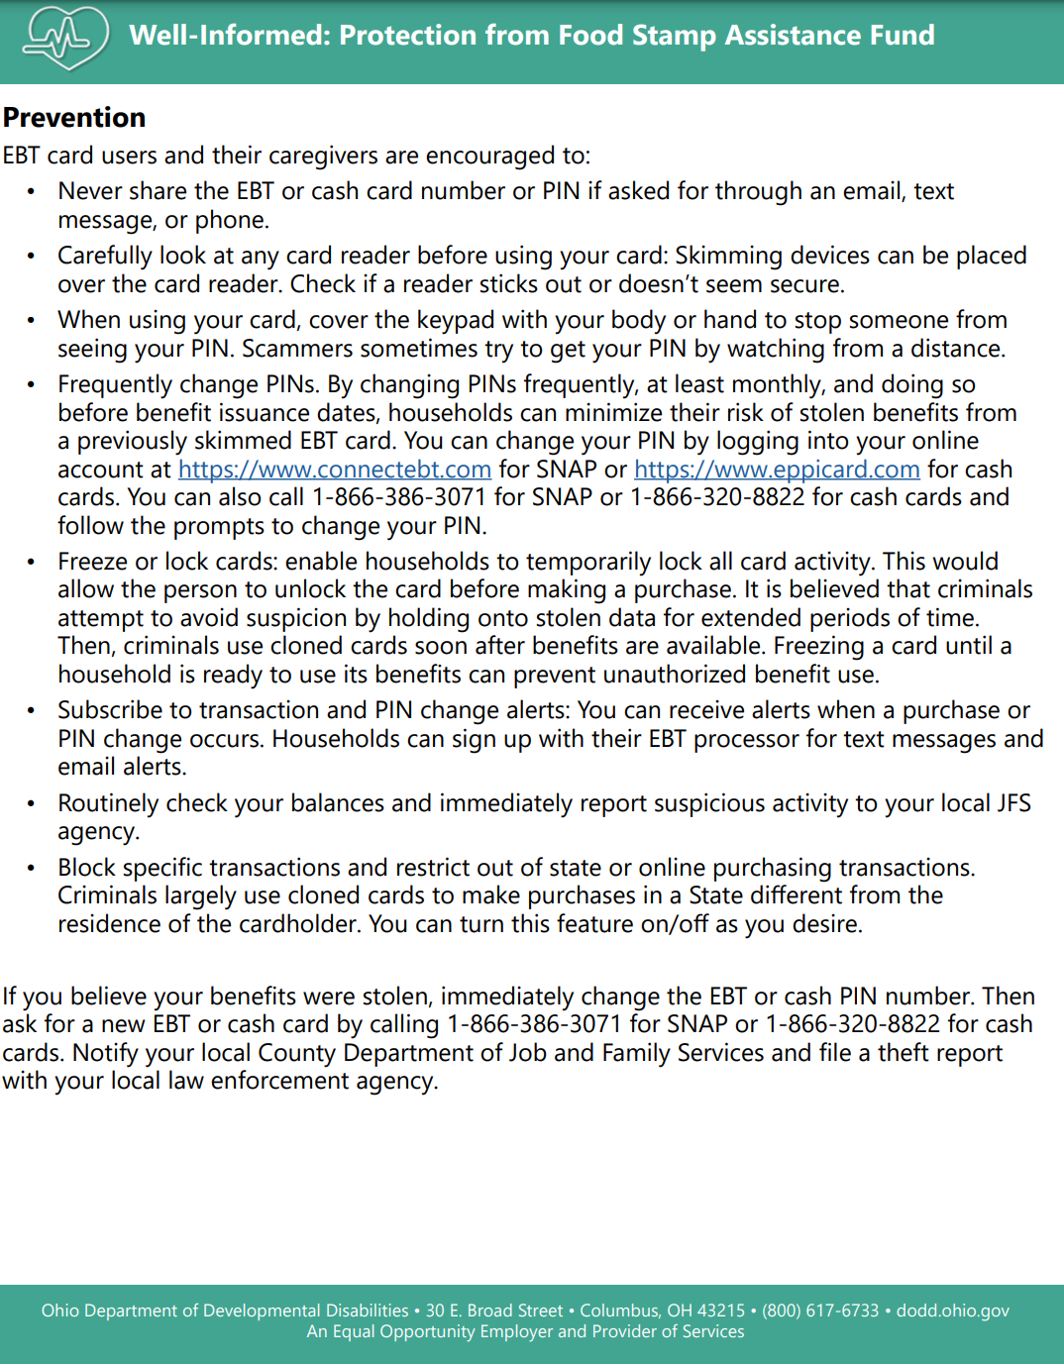
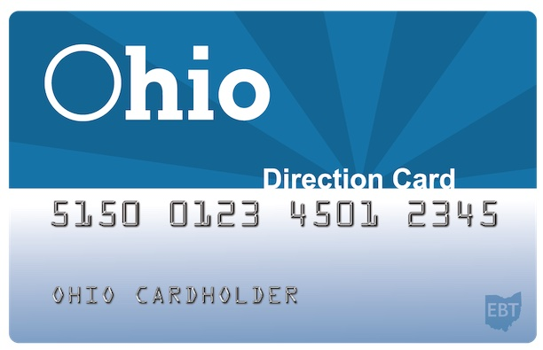
QCO Department

Slide 6
QCO Department
DSP Appreciation
September 3rd- Active Day and Vitality Supported Living
September 4th - Maples and ACRS
September 5th - New Avenues and Accessible Homes
September 9th - BHRS and Leeda NE
September 10th - Achieving Dreams and A lasting Impression/Greenelight
September 11th-Willing Hands and Diamondstar
September 16th- REM and Manor Home
September 17th- Viaquest and Walden Residential
September 18th- CLW 1 & 2
September 20th Richwood Residential and Grape Escape/Clearwater Homes
September 27th- Devoted Guidance, PEGI, Ellis and all Independent Providers

Slide 7
How can you recognize your DSP’s
Thank You cards
with personalized
handwritten notes.
Give a self-care package
that includes
lotion, lip balm, essential oils.
Host a Family Fun Day Picnic
Give a potted plant with a note “Thanks for helping us Grow”
Gas Gift Cards
Host Prize Raffles
Grocery Gift Cards
Direct supervisors- record a quick personal thank you message and send to your DSP’s
Hire a food truck and invite staff to stop in
throughout the day to pick up a meal
QCO Department

Slide 8
QCO Department
Honoring DSP’s of the
Month for 2024
SAVE THE DATE
September 26, 2024
4:00PM-7:00PM

Slide 9
QCO Department
EVV Enhancement
Description: This two-hour course will guide agencies and independent providers through the enhancements made to the EVV system.
Intended Audience: Agency administrative staff and independent providers using the Sandata system. This training is not intended for agency-employed direct care workers or participant-directed only providers who receive payment through a financial management service.
EVV
Aggregator Training
Description: This one-hour course will guide agency providers using an alternate vendor through the recently implemented changes to reporting and sign-in.
Intended Audience: Agency provider administrative staff using an alternate vendor.
Scheduling Training
Description: Scheduling is an optional feature for agency providers and is available to help direct care workers capture visits. This course will show how to create and manage schedules.
Intended Audience: Agency provider administrative staff intending to use the Sandata scheduling solution.
Notes:
Additionally, Sandata is offering for providers who have questions or need clarification on the enhancements. Office hours are available twice a day through August 31.
Office Hour – 10:30 a.m. ET sessions
Office Hour – 2:30 p.m. ET sessions

Slide 10
QCO Department
FAQ
Where can I locate my OHID account information?
When I try to login to the SMC application on a smart device/phone, I am getting an “inactive user error.” What do I do?
What do I do if my email address in OHID is not the same email address in the Sandata EVV Portal/Sandata Aggregator system?
Why am I getting an error when I try to update my password in the Sandata EVV Portal and Sandata Aggregator system after I have logged into OHID?
What is an authorization in the EVV Sandata system? Is an authorization necessary to capture a visit?
I can’t find a recipient’s record, is there something I need to do?
Did historical accounts that had an active payer, program, and service tied to a recipient generate an authorization for the recipient in the enhanced system?
Notes:
Where can I locate my OHID account information? Providers must have an OHID account to access the Sandata systems. If you already have an OHID but need help signing in, account recovery can be found at OHID online. Additional support can be found at the Help OHID page. If you do not have an OHID account, go to OHID online to create one. The OHID Multi-Factor Authentication (MFA) Job Aid provides assistance in creating an account.
What do I do if my email address in OHID is not the same email address in the Sandata EVV Portal/Sandata Aggregator system? Providers with a mismatching email address will need to either update their email address in OHID or the Sandata EVV system to ensure that they match.
What is an authorization in the EVV Sandata system? An authorization in the Sandata system is the record that links the recipient and the provider. Authorizations are found in the Recipient Management menu, Program tab
Is an authorization necessary to capture a visit? Authorizations are not necessary to capture a visit, however, authorizations are necessary to get a visit in the Verified or Processed status to be eligible to be matched to a claim. Without an authorization for the recipient that matches the payer, program, and service on the visit, the visit will show an Unauthorized Service exception. A correct authorization added after the visit is captured will be resolved automatically in the system if the authorization covers the date of the visit. For more 6 Updated: 8/7/2024 Effective: 7/1/2024 information on creating authorizations visit Creating an Authorization on Sandata On-Demand.
When I try to login to the SMC application on a smart device/phone, I am getting an “inactive user error.” What do I do? Reset your password directly on the SMC application and follow prompts to reset your password. You should be able to successfully login after resetting your password
Why am I getting an error when I try to update my password in the Sandata EVV Portal and Sandata Aggregator system after I have logged into OHID? Once an OHID account has been created, passwords can only be updated through that platform. Passwords cannot be reset in the Sandata system.
I can’t find a recipient’s record, is there something I need to do? Locating a recipient record can be done by changing the filter options to see all recipient records. Follow these steps: a) Select Recipients, then select Recipient Management. b) Select the Filter option in the upper right corner of the screen. c) Change the Status field to Select Status. d) Select Apply Filters. e) The screen will be refreshed to show all Recipient records.
Did historical accounts that had an active payer, program, and service tied to a recipient generate an authorization for the recipient in the enhanced system? Yes, Sandata did migrate the payer, program, and service details to create an active authorization to provider accounts, however some migrated authorizations will appear on the recipient screen as locked and are unable to be edited at this time. If a user sees an authorization that is locked and they are unable to edit the authorization, or the authorization is inaccurate, they can delete the authorization by clicking the bin icon and create a new one.

Slide 11
QCO Department
FAQ
Can I use an alternate vendor as an independent provider?
My client doesn’t want the device in their home. What should I do?
I’m already using an alternate EVV system? Do I have to do anything different?
What do I do when I receive an error message (i.e., 404) when attempting to access website links for EVV?
When will ODM start requiring EVV as a condition of payment?
REMINDER- EVV should be being used at all times to record visits. The data collected is used during audits and eventually can effect your ability to receive accurate reimbursement.
Notes:
Can I use an alternate vendor as an independent provider? No. Only agency providers are eligible to use an alternate EVV system.
I’m already using an alternate EVV system? Do I have to do anything different? No. Existing vendors are not required to do anything differently, including system retesting if applicable.
My client doesn’t want the device in their home. What should I do? Devices are no longer placed in individual's homes. Devices are assigned to providers or caregivers and should be kept with them.
What do I do when I receive an error message (i.e., 404) when attempting to access website links for EVV? Clear cache, cookies, and history and if this does not resolve the issue, please contact the EVV hotline at 855-805-3505. To clear cache, click the link below that corresponds to your preferred web browser:
When will ODM start requiring EVV as a condition of payment? The first phase of the claims adjudication process begins with home health services billed through State Plan Fee for Service (FFS). Beginning October 1, claims for these services only will require complete EVV visit data to receive payment. If the information submitted does not match visit records, claims may be denied. For a list of services subject to EVV, please find the ODM EVV Program and Service Code Guide here. Additional services subject to program participation will be announced in future phase(s). In accordance with OAC Rule 5160-32-02 EVV data collection guidance, ODM will communicate with affected service providers at least three months prior to initiating the process of claims denial or post payment penalty review. To support this process, data will be made available in the coming weeks to support efforts to comply with EVV requirements. ODM will provide information to all providers when this is available.
What do I need to do if I log in to eTrac and I receive an error that my Medicaid number does not match? If the Medicaid ID number does not match when attempting registration, please contact the EVV Provider Hotline at 855-805-3505​ for assistance.

Slide 12
Outcome Tracking System
Memo Monday
There was a 79% statewide questionnaire completion rate, which is the highest percentage to date! Great Job!
Starting October 1, 2024, the OTS will be available for participating Adult Day and Employment providers, ICFs, DCs, and county boards to enter data for the people they provided services to in the month of September 2024. Users will have six months to enter data; 10/1/2024 – 3/31/2025.
In preparation for the upcoming Reporting Period, please register for one of these trainings:
OTS 15-day pull training – this training prepares ICFs, DCs, and county boards in updating information to ensure an accurate representation in OTS.
2. OTS Full training – this training prepares all OTS users on how to assign records and complete questionnaires within the reporting period.
Notes:
The Outcome Tracking System (OTS) application replaced the Employment First Outcome Tracking System (EF OTS) in October 2019. The new OTS application captures how people are spending their days. It looks at systems and services outcomes: those larger outcomes that are happening with services. This new application does not focus on individual outcomes that are identified within a person’s plan (ISP/IP). The Ohio Department of Developmental Disabilities (DODD) will use the data from the OTS application to better align policies, procedures, and legislation that will improve how people live, work, play, and thrive in their communities.

Slide 13
ICF Assistive Tech Grant Opportunities
Funding Now Available for Assistive Technology for People Living in ICFs
Attention: ICFs
Intermediate Care Facilities (ICFs) now have access to funding through a new ICFs and Assistive Tech Fund, to purchase Assistive Technology for the people who live there, based on connections made in the Rapid Response System, or through other consults with Supportive Technology professionals.
This funding is specific to the Assistive Technology needs of people who live in ICFs. To access the funding:
Gather the individual's team to identify unmet needs.
Provide a brief description of the need(s) (without including protected health information) in the Rapid Response System.
Connect with technology vendors to determine the most appropriate option that will best meet the need.
Complete the ICF Assistive Technology Request for Application.
Please contact technologyfirst@dodd.ohio.gov with any questions.

Slide 14
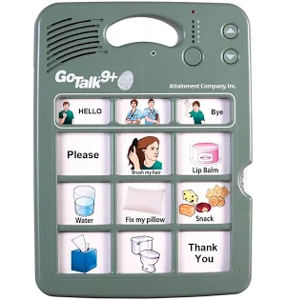
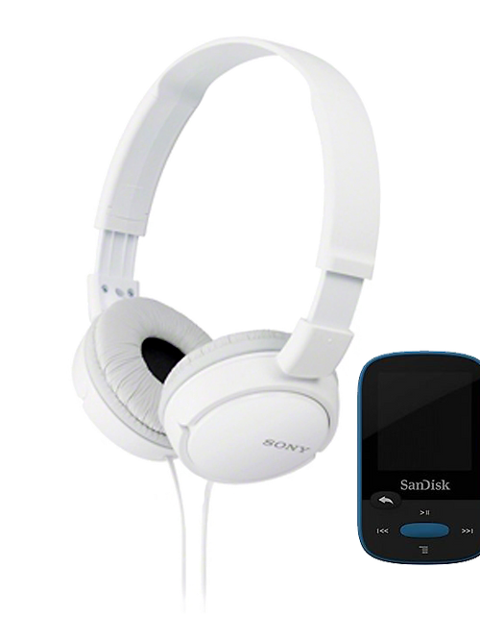
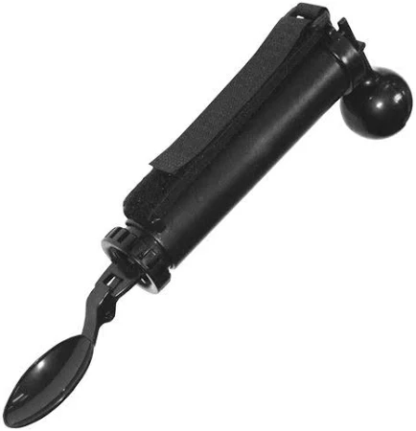
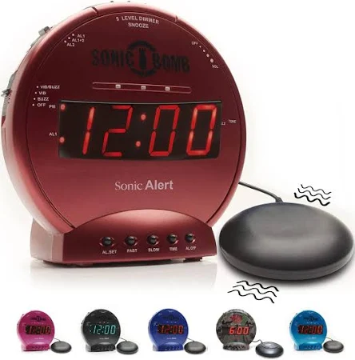
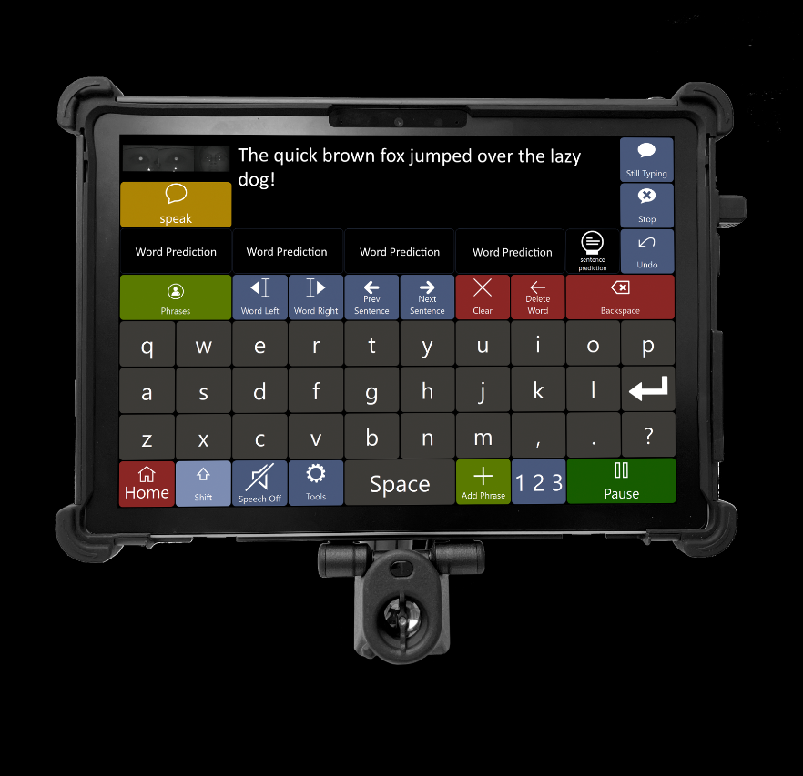
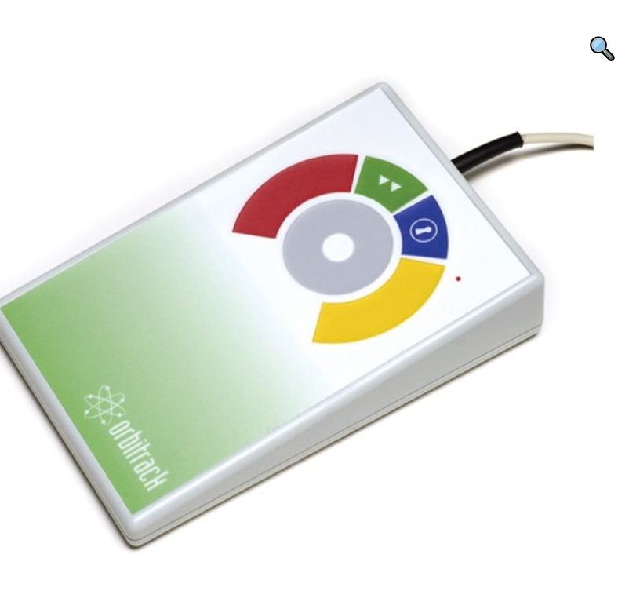
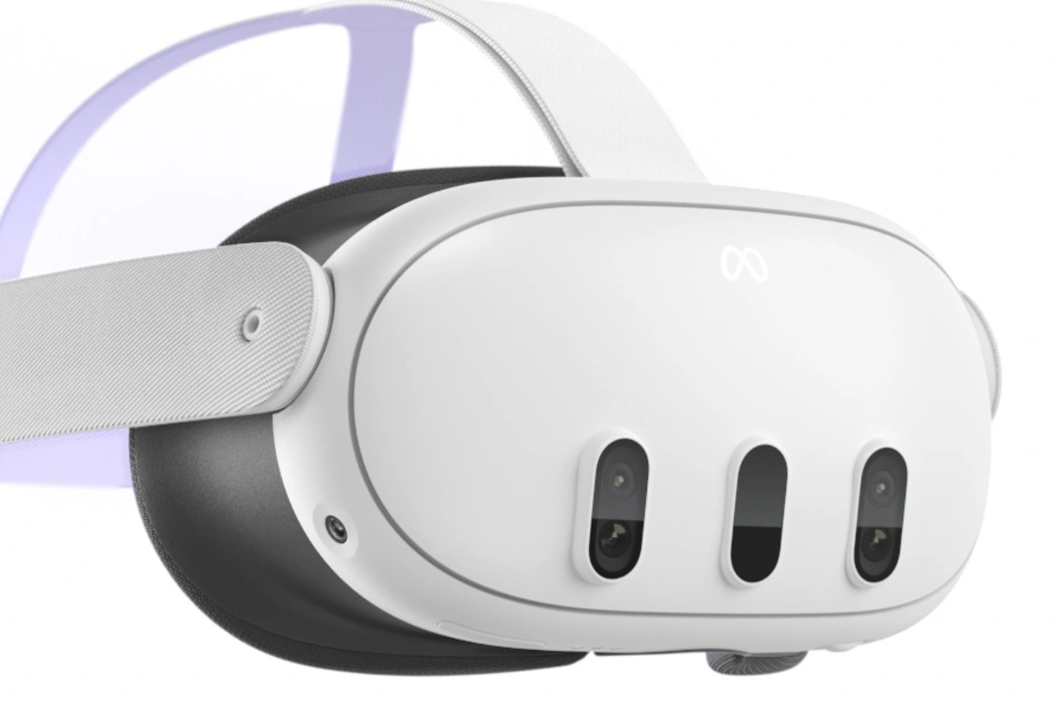
B-Calm Audio Sedation System
iBill money identifier
Sonic Bomb Alarm Clock and Bed Shaker
Go Talk 9+
Steady Spoon
Eyegaze Edge
Cruise Adapted Track Pad
Meta Quest 3
Notes:
"Regional Technology Hubs" are spaces across Ohio where training, capacity-building, and access to supportive tech experiences take place.
There are Regional Tech Hubs in all 6 Superintendent regions, and each one is based on the needs of the region. Grants provided through DODD
The project provides funding for Regional Technology Hubs in the six county-board superintendent regions across Ohio. The main purpose is to support Ohio communities in creating partnerships, networks, and collaborations locally to increase supportive technology capacity and outcomes for people with developmental disabilities.

Slide 15
Community Inclusion activities
https://wethrivetogether.org/
QCO Department
15

Slide 16
And So Much More!
QCO Department

Slide 17
QCO Department
Community Engagement & Employment
Presentation
Britta Hough Community
Life Engagement Project Manager
17

Slide 18
Upcoming Training
MUI Referesher Training- August 21, 2024
Initial Medication Certification Category 1– September 23 & 24, 2024
Initial Provider Training- October 9, 2024
Annual Provider Training- October 29, 2024
CPR/First Aid Blended Learning – October 7, 2024
Initial Medication Administration Category 2 & 3- August 19 , 2024
Renewal Medication Certification Category 1, 2 & 3 – August 20, 2024
Nonviolent Crisis Intervention® (NCI™) - September 4, 2024
Autism Spectrum Disorder
All classes listed above are open for registration on the Ashtabula County Board of Developmental Disabilities website under the Provider support tab. https://www.ashtabuladd.org/

Slide 19
OPEN MIC

Slide 20
Thank You!
Next Provider Meeting
September 12, 2024
Station MD & Moms Meals

