Slide 2
Provider Meeting
December 14, 2023

Slide 3
Moises Cirilo- Early Intervention
Ann Simeone- Investigative Agent

Slide 4
DSP of the Month
Marlin McPeters- Accessible Homes
Maura Zalik- Active Day
Leo Sean Talikka- Brighter Horizons
Notes:
DSP of the month winners

Slide 5
County Board Updates
2024 Campaigns
ACBDD Holiday Shut Down
Rate Increases
Winter Weather Policies

Slide 6
2023 Campaign- Provider Meetings.
January 11, 2024-
February 8, 2024- Technology- ATV
March 14, 2024- DD Awareness
April 11, 2024-
May 9, 2024 -Accessibility and Inclusion- Technology Day
June 13, 2024- Resource Fair
July 11, 2024-
August 8, 2024-
September 12, 2024- DSP Appreciation MONTH
October 10, 2024-
November 14, 2024- Gratitude and Reflection- Family appreciation
December 12, 2024 Recap of the past year- Future goals and planning
6

Slide 7
What is ISSUE 2?
On November 7, 2023, Ohio became the twenty-fourth state to legalize adult use (recreational) cannabis. Issue 2, a citizen-initiated statute, passed with about 57% of the vote. This became effective on December 7, 2023.
Issue 2 permits adults over the age of 21 to buy from a state-licensed source and possess up to 2.5 ounces of cannabis and to grow cannabis at home. The law also establishes the Division of Cannabis Control within the Department of Commerce, which will regulate and license where cannabis can be commercially cultivated, tested, and sold. It is expected that the regulatory scheme will not be established until 2024. Marijuana sales will be taxed at 10%, with the revenue directed toward a cannabis social equity and jobs program.
7

Slide 8
How does this affect employers?
Issue 2 protects employers’ ability to manage their workplaces and employees similar to the employer protections in the Ohio Medical Marijuana Law.

Slide 9
Does an employer have to accommodate or permit cannabis use now that issue 2 has passed?
NO
An employer is not required to permit or accommodate and employee’s use, possession, or distribution of cannabis. RC3780.35(A)(1)
Can an employer refuse to hire or discharge an employee that is a cannabis user?
YES
An employer may refuse to hire, discharge, discipline, or otherwise take an adverse employment action against a person with respect to hire, tenure, terms, conditions, or privilege's of employment because of that person’s use, possession or distribution of medical marijuana. RC 3780.35(A)(2)

Slide 10
Can an employee be terminated for off-duty cannabis use?
YES
An employer may refuse to hire, discharge, discipline, or otherwise take an adverse employment action against a person with respect to hire, tenure, conditions, or priviliges of employment because opf that person’s use , possession, or distribution of cannabis. RC 3780.35 (A)(2)
Can an employer still preform drug tests on their employees? (Random, routine, and preemployment.)
An employer may still establish and enforce a drug testing policy, drug-free workplace policy, or zero –tolerance drug policy.
RC 3780.35(A)(3)
Nothing interferes with federal restrictions on employment, including U.S. Department of Transportation regulations. RC 3780.35 (A)(4)
10

Slide 11
Can an employer be sued for employment actions related to cannabis?
NO
A person may not commence a cause of action against an employer for refusing to hire, discharging, disciplining, discriminating, retaliating, or otherwise taking an adverse employment action against him or her with respect to hire, tenure, terms, conditions, or privileges of employment related to cannabis use. RC 3780.35 (A)(5)

Slide 12
Provider certification standards and employment expectations are that DSP’s shall not be under the influence of controlled substances. Cannabis is no longer considered an illegal drug and your policy should reflect the now prohibition of the use of controlled substances.
5123-2-08(G)(9)(f)
(9) Ensure that a direct support professional does not:
f) Use or be under the influence of the following while providing services:
Alcohol;
(ii) Illegal drugs;
(iii) Illegal chemical substances;
or (iv) Controlled substances that may adversely affect the direct support professional's ability to furnish services.

Slide 13
Workers compensation
Unemployment
A person who is terminated because they used cannabis is considered to have been discharged for “just cause” under the unemployment compensation Law if that use violated:
Employer’s drug free workplace policy
Zero –tolerance policy (or)
Any other formal program or policy regulating cannabis use.
The person is ineligible to serve a waiting week or receive unemployment benefits for the duration of unemployment. RC 3780.36(B)
The administrator of Workers’ Compensation may continue to grant rebates or discounts on premium rates to employers that participate in a drug-free workplace program under the Bureau of Workers’ Compensation. RC 3780.36 (A)(6)
The BWC drug-free workplace program requires testing for marijuana.
13
Notes:
MRC training information

Slide 14
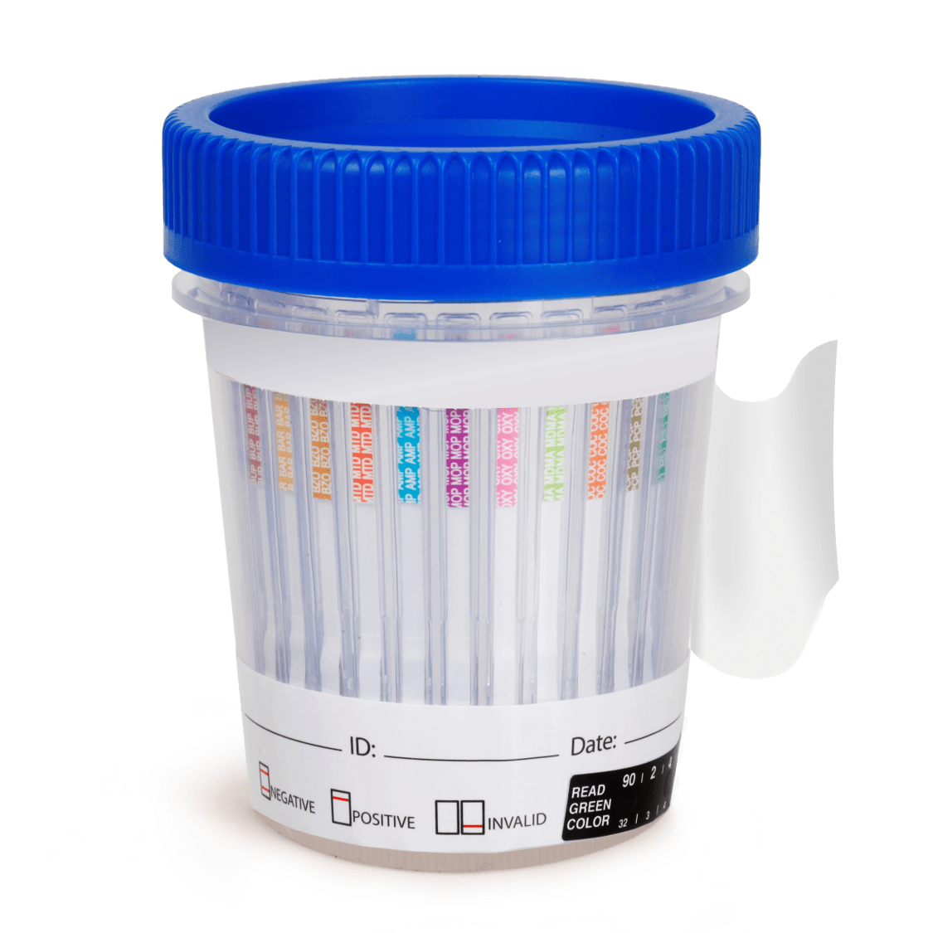
Drug Testing
A positive drug test does not equal active impairment.
Best practices:
Have strong substance abuse policies in place.
Determine how and when you will drug test.
Clearly indicate how you will handle cannabis and medical marijuana use.
Provide training to your staff on impairment and substance abuse.
Be consistent with discipline and enforcement of your policies.

Slide 15
Other considerations…
A landlord may prohibit cannabis consumption by combustion if that prohibition is included in the applicable lease agreement. RC 3780.33 (F)
A landlord may prohibit cultivating, growing, and possessing cannabis plants if that prohibition is included in the applicable lease agreement. RC 3780.29(D)
A public place is not required to accommodate cannabis use. RC 3780.34 (H)(4)
Individuals cannot smoke, vape, or use any other combustible cannabis in a vehicle, motor vehicle, streetcar, trackless trolley, bike, watercraft, or aircraft. RC 3780.89(D)(2)

Slide 16
ACBDD Policy
The Ashtabula County Board of Developmental Disabilities is and will continue to be a drug-free workplace.
The Board prohibits the use and the possession of cannabis by its employees and the Board does not permit, accept or accommodate the use of cannabis.

Slide 17
QUESTIONS?

Slide 18
Monthly Rate Calculator
The Monthly Rate Calculator, or MRC, is part of the Medicaid Service System, or MSS, and is a way to project costs and service hours for billing. MRC takes the 12-month waiver span and breaks it into projected service hours and costs for individual months.
Effective January 1, 2020
18

Slide 19
Monthly Rate Calculator
MRC will determine what the Daily Billing Unit is for each day of the calendar month. The DBU is a flat rate that may be billed by the provider for each date of service. It is determined by taking HPC and On-Site/On-Call costs for each person in a calendar month and dividing those costs by the total number of dates of service in the month.
A date of service is defined by OAC 5123-9-31 (B)(5) as any day when the person is a resident of the home, including days when the person is temporarily away from the home, such as planned vacations, visits with family or friends, respite services, or hospital visits. Dates of service do not include days when a person is admitted to a nursing facility or intermediate care facility.

Slide 20
Monthly Rate Calculator
Planning
Service and support administrators, or SSAs, project costs as accurately as possible to reflect a person’s real life for their full 12-month waiver span.
To do this, SSAs need to consider
the typical patterns of a person’s Homemaker/Personal Care usage,
any adjustments to a person’s schedule that were made based on holidays, day service program closures, and weekends,
and any other anticipated changes to a person’s direct service hours.
Notes:
Once cost projections are entered, the site should be shared with the provider for review.
If the total costs exceed a person’s Ohio Developmental Disabilities Profile, or ODDP, funding range, SSAs submit a request for prior authorization.
In accordance with OAC 5123:2-9-07 (C)(4), the Ohio Department of Developmental Disabilities, or DODD, shall not consider a request for prior authorization submitted after the end date of the waiver eligibility span for which the request is made.

Slide 21
Monthly Rate Calculator
Planning Unscheduled Services
Unscheduled time should be applied to the month or months in which it is expected to be used.
Teams should look at historical service usage to identify when a person tends to use more service hours and how many additional service hours are typically needed.
Teams should consider patterns of work or day program closures, illnesses, or medical appointments.
Notes:
When units are entered as unscheduled without specific start and end dates, the unscheduled units will be distributed equally across the full 12 months of the person’s span. This could cause
unscheduled time to be applied to a month in which it was not needed, making it appear as though the provider under-delivered services,
or unscheduled time not to be applied to a month in which it was needed, causing the provider to deliver more units than were authorized, which would require an adjustment in the Cost Projection Tool.

Slide 22
Monthly Rate Calculator
After cost projections are finalized, no changes should be made unless:
a person moves to or from the site,
a person living at the site starts or stops day programming,
or circumstances cause an increase or decrease of more than 3% in the hours of HPC provided at the site during the calendar month.
Notes:
Retroactive changes to the Cost Projection Tool, or CPT, are permitted for up to two months. For example, a provider can request additional hours for January by providing documentation to the county board regarding the person’s need for the additional hours. March 31 would be the last date a retroactive change would be permitted.
The CPT must be adjusted whenever a provider produces documentation that one or more people in the home required additional direct support hours.

Slide 23
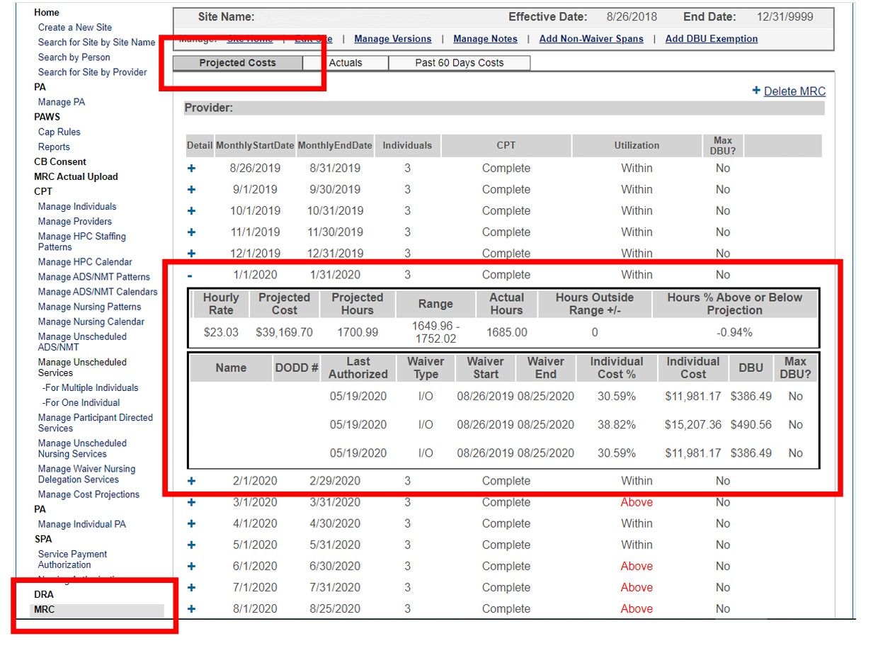
Notes:
MRC projected costs: based on information entered by the county board, the projected cost for 01/01/2020 – 01/31/2020 is $39,169.70, and the projected hours are 1700.99. The provider has entered 1685 service hours for the month, which is within 3% of the cost projection, so no adjustments will be necessary.

Slide 24
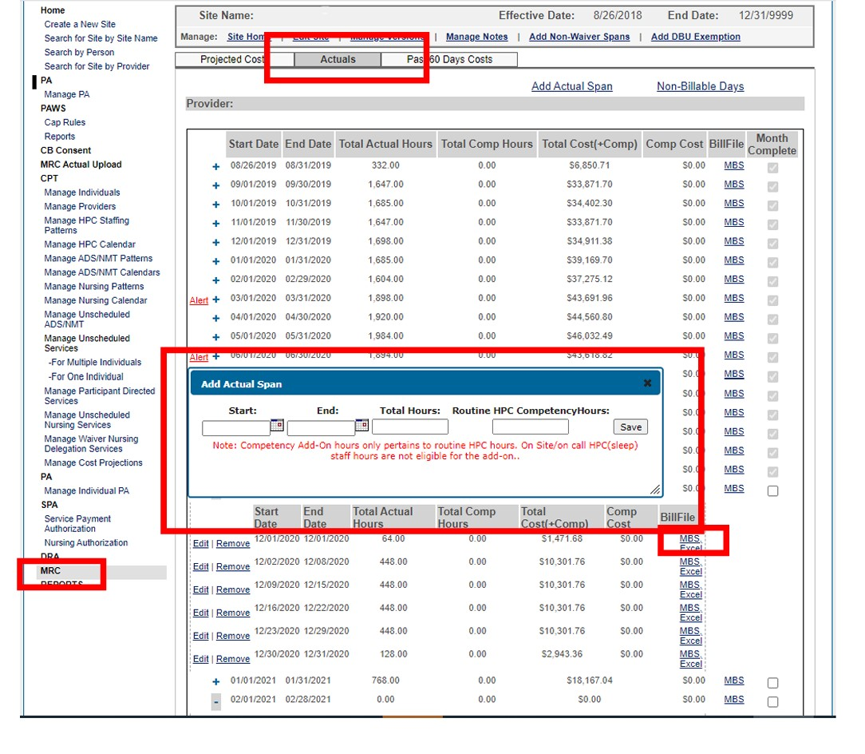
Monthly Rate Calculator
Notes:
Reporting staff hours: Go to the ‘Actuals’ tab and click on ‘Add Actual Span’. You can enter anywhere from a single day to the entire month. Enter the start date and the end date of the actual span and the total number of staff hours provided during the span. Staff hours are based on the number of hours of service provided. For instance, if you had staff onsite 24 hours per day for an entire week, the total hours would be 168. It would not matter if you had three staff in each day to work an 8-hour shift, the total staff hours would be 168. If you always had two staff onsite, the total hours would be 336. Routine HPC competency hours: if one or more of your staff were eligible for the competency add-on, you would enter the number of hours that the add-on would be eligible. For instance, if you had three staff in each day, but only one staff was eligible for the add-on, you would enter 8 hours for each day the eligible staff worked. Submitting claims: You will see two links below ‘BillFile’: MBS and Excel. Click on ‘MBS’ to generate a billfile you can submit to eMBS to finish your billing. Directions for uploading billfiles are available in eMBS in the user guides.

Slide 25
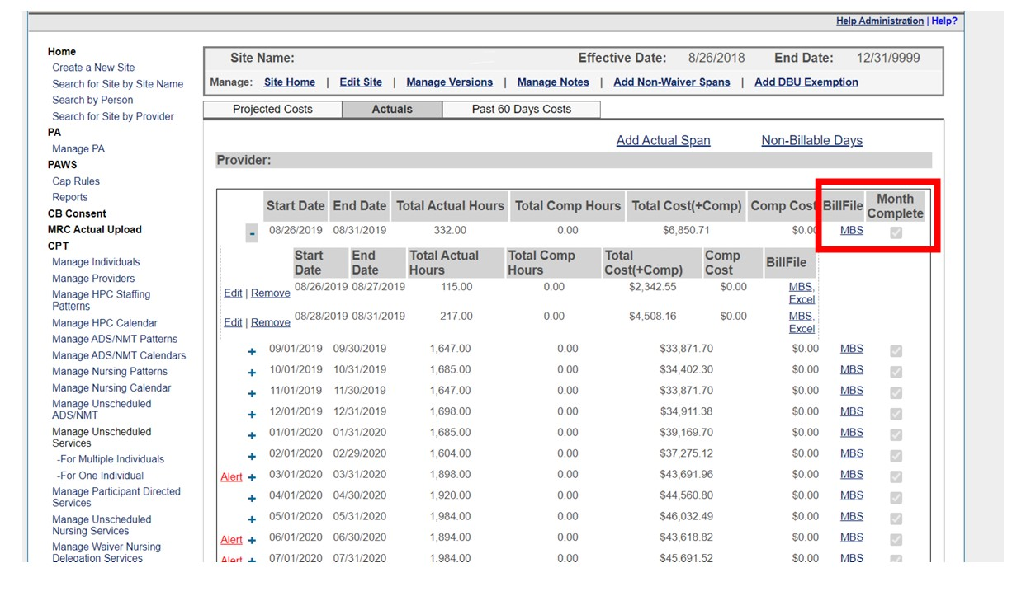
Monthly Rate Calculator
Notes:
At the end of each month: When you have submitted actuals for the entire month, click on ‘Month Complete’. This is the most important step in making sure your billing is correct and not subject to being paid back in the case of an audit or fraud investigation. Clicking “Month Complete” calculates any adjustments that need to be made to the month if more or less service hours are provided than were originally projected. As long as the amount of actual service hours you deliver is within the 3% margin of the hours projected, no you won’t need to submit adjustments to eMBS. If the percentage is less than 3%, you will need to submit adjustments. Click on the ‘MBS’ link next to where you checked month complete to generate a billfile that you would then upload to eMBS. If the percentage is more than 3%, you will need to speak to your county board as they would need to decide if costs need to be re-projected.

Slide 26
Monthly Rate Calculator
ALL staff hours enter must be documented in accordance with OAC 5123-9-30 (E).
If services in an MRC span have been changed after you have already submitted claims and checked the complete box for that month, DO NOT just recalculate and resubmit the claims unless you know why the authorization has been changed and the provider has been involved in the change.
DO NOT “check” the “Month Complete” box in the MSS/CPT/MRC Actuals screen unless you are assured no changes will occur to this MRC span. This includes when the provider is requesting a reduction or addition of hours effecting this span. If you have been assured no changes are pending, then “check” the box, recalculate all claims for all individuals in the MRC site for the span and re-submit the claims if services provided were under the 97% threshold.
If “actuals” for the MRC span are less than 97% or more than 103%, see document on “Over/Under” the range.

Slide 27
Over/Under
Services in MSS/CPT should be developed using the needs of the individuals in each MRC site and the known resources available to meet those needs.
If services are Over the Range (103% or more of the authorized hours) during MRC span, the provider can (and should) contact the CB SSA explaining the circumstances that caused the Overage.
If services are Under the Range (97% or less of the authorized hours) during MRC span, the provider can (and should) contact the CB SSA explaining the circumstances that caused the underage.
In both of these cases, providers are being underpaid which hinders their ability to adequately hire, train and retain DSP’s. When service hours are over the range, the provide has to compensate staff for services not billed. When service hours are under the range, often times the provider has been under compensated for the hours billed. If the ratios were reduced to the actual hours deliverable, the average hourly rate billed would increase.

Slide 28
More Information:
https://dodd.ohio.gov/providers/monthly-rate-calculator/

Slide 29
QUESTIONS?

Slide 30
Community Inclusion activities
https://wethrivetogether.org/
30

Slide 31
Open Mic.

Slide 32
11 Days Until Christmas
17 Days Until 2024

Slide 33
Thank You!
Next Provider Meeting
January 11, 2023
See you Next Year!
33

