Slide 1
Provider Meeting
May 9, 2024
1:00PM-3:00PM

Slide 2
SSA Department
Jessica Bruckman SSA

Slide 3
DSP of the Month
Blake Hinkle
Siarra Brazil
Laura McCormick
Notes:
DSP of the month winners

Slide 4
SSA Department
ACBDD SSA Department- Temporary Restructuring
Interim SSA Department Director: Toni Scurpa
SSA Manager: Lisa Fuller-Grippi
Operations Manager/Interim SSA Manager: Stephanie Chizmadia
SSA Supervisor Assignments will be effective 5/2/2024

Slide 5
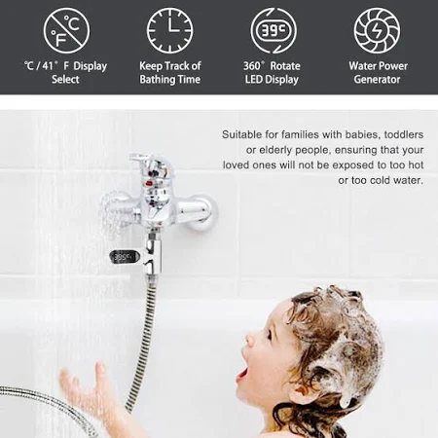
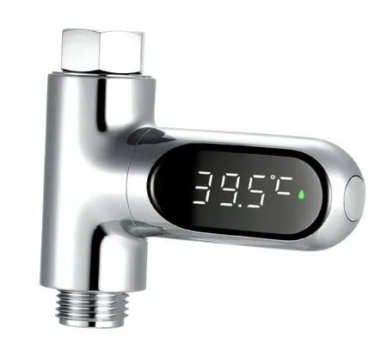
ISS Department
Burn Prevention
An overwhelming 85% majority of scald burns occur in the home, compared to 74% for other types of burns. 3 In children < 5 years of age, the in-home injury rate increases to 95%. Scald burns (from hot water, other liquids, and steam) comprise 35% of overall burn injuries admitted to U.S. burn centers. -American Burn Association

Slide 6
Medicaid Manager
Potential Medicaid Loss and Team Responsibilities
Medicaid renewal and Medicaid Loss Notifications are sent to the CB
Internal Procedure to be developed to address and prevent Medicaid loss
Meeting with ODJFS to establish a relationship
Work together with ODJFS to get verifications needed
SSA Training on follow up and procedures
Medicaid Loss can impact the services an individual receives
Medicaid Loss can also affect provider reimbursement

Slide 7
OOD Presentation
Presenter: Dustin Schwab
Works4Me Project Director

Slide 8
QCO Department
July 2024 Waiver Service Rate Automation
May 3- 6th Rate automation occurred for all counties
MSS was down during this time
Providers should receive emails regarding the updates (if authorized on the PAWS)
If you have any issues concerns or questions please reach out to MSSSupport@dodd.ohio .gov

Slide 9
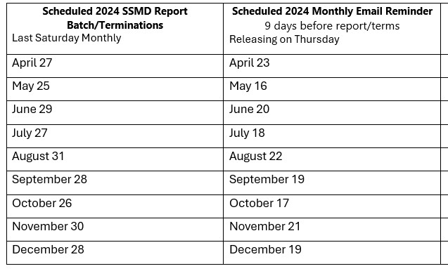
QCO Department
Monthly Reminder Emails!
The Ohio Department of Medicaid is required by federal and state statutes to administer and monitor the integrity of its program. Central to that effort is working with Medicaid providers to ensure all reporting and administrative requirements are met.

Slide 10
QCO Department
Now available - Leadership LAUNCHpad scholarship opportunity, provided by the HCBS ARPA Workforce Grant Project. Eligible individuals include both agency provider employees and independent providers working in Direct Support Professional and/or Frontline Supervisory roles. Applicants must be providing HCBS services in Ohio.

Slide 11
QCO Department
Ohio EVVV Visit Verification and Alternate Certification Documents Update
Effective July 1, 2024
This is important if you are using an alternate EVV provider to record your visits.
Providers MUST comply with the following documents:
Technical Specifications through June 30, 2024
Proposed Technical Specifications in Production effective July 1, 2024
Alternate EVV Business Rules, effective July 1, 2024
Alternate EVV System Checklist, effective July 1, 2024
REMINDER- EVV should be being used at all times to record visits. The data collected is used during audits and eventually can effect your ability to receive accurate reimbursement.

Slide 12
RESOURCE Fair
June 13, 2024 Ashtabula Towne Square Mall
11:00AM- 3:00PM
3:00PM-4:00PM Vendor Social
4:00PM-6:00PM
Life Bridge Remote
Rest Assured
Threshold Residential Services
Family Pride of NEO
Friendship Clubhouse
Molina Healthcare
Lake Area Recovery Center
We Thrive Together and Ohio Tech Ambassadors
Willing Hands
Viaquest
Achieving Dreams
ActiveDay
Greenelight Workforce
CLW
A Lasting Impression

Slide 13
QCO Department
Compensation Survey
What?
Determines how provider agencies use the Medicaid service rate increases to support the direct care workforce.
This is a tool that helps communicate your stories regarding the DSP workforce to Public and Legislative bodies.
Why?
House Bill 33 appropriated $1.5 Billion dollars to increase DSP wage.
As a result of this increase there is now a requirement to report annual direct care worker wages to the Ohio General Assembly, the Governor, and the Joint Medicaid Oversite Committee.
Timeline?
April 15, 2024 Survey window will open (You will receive an email with a link)
June 30, 2024 Surveys are due
December/2024- Report will be released
13
Notes:
You will receive notification of this survey through and email from DSPcomp@dodd.ohio.gov (It is important to check your spam.
Any agency that billed DODD for HPC or Adult Day Array in 2023 are included
Independent providers and providers that do not provide waiver services are not included
Administrative Staff are not included

Slide 14
Upcoming Training
MUI Referesher Training- May 14, 2024
Initial Medication Certification Category 1– June 3 &4, 2024 (FULL)
Initial Provider Training- June 12, 2024
Annual Provider Training- July 30, 2024
CPR/First Aid Blended Learning – June 10, 2024
Initial Medication Administration Category 2 & 3- June 24, 2024
Renewal Medication Certification Category 1, 2 & 3 – June 25, 2024
Nonviolent Crisis Intervention® (NCI™) - July 30, 2024
Autism Spectrum Disorder
All classes listed above are open for registration on the Ashtabula County Board of Developmental Disabilities website under the Provider support tab. https://www.ashtabuladd.org/

Slide 15
QCO Department
https://wethrivetogether.org/
Community Inclusion activities
15

Slide 16
And So Much More!

Slide 17
Thank You!
Next Provider Meeting
July 11, 2024
Resource Fair ~June 13, 2024

