Slide 1
Welcome
Provider Meeting
October 12, 2023

Slide 3
DSP Of the Month
September
Rebecca Windle- Walden Residential
Epiffany Watkins- A Lasting impression
Dave Stanco- Accessible Homes

Slide 4
October DSP’s Of the Month
Denise Cross-
Active Day
Hugh Hubbard-
Vitality Supported Living
Trudy Hazen-
Brighter Horizons Residential Services, Inc

Slide 5
Notes:
Survey- Please give your feedback

Slide 6
Reimbursement Rate increases
January 1, 2024
https://dodd.ohio.gov/providers/billing/rate-increase
July 1, 2024
https://dodd.ohio.gov/forms-and-rules/rules-under-development/rule_updates

Slide 7
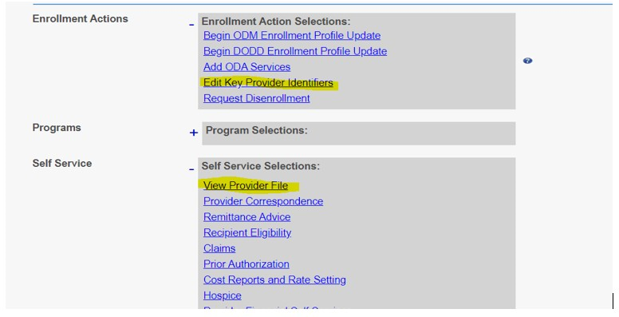
PNM Update Email
Provider Contact Information in Provider Network Management
Attention: All Providers, DCs, ICFs
As a reminder, correspondence sent out from Provider Network Management (PNM) is sent to the contact listed in the Primary Contact Information in the Provider File.
Please review and verify your primary contact information by logging in to PNM, select Reg ID(s), go to Self Service->View Provider File. If you find that the Primary Contact is outdated, please go to Enrollment Actions->Edit Key Provider Identifiers.
Memo Monday- October 9, 2023
Notes:
Most DD providers should be okay since PSM has been updated and most providers have kept their info. If asked directly I would always tell providers to go in and check their info. DODD did not own all the data when we combined systems. Some of this data combinations have resulted in outdated info being the current info. I have told everyone they should go in and check. If only to ensure it is correct. I will have our communications team look to see if they can put it out more widely. I appreciate you asking and am always happy to give/find answers if I can.
Jared Mutchler

Slide 8
DSP Retention Payment Program Opt-In Now Open Attention: Agency Providers
Agency Providers can opt-in to the final quarter of the Retention Payment Program until October 15, 2023. Instructions on how to opt-in to the program can be found here. Independent providers of eligible services with claims paid in the 3rd quarter will receive payment. Independent providers do not need to opt-in to the program to receive a retention payment. Additional details, frequently asked questions, and program guidance can be found at https://dodd.ohio.gov/providers/RetentionPayment. Providers can email retentionpay@dodd.ohio.gov with questions regarding reporting and program requirements.
8

Slide 9
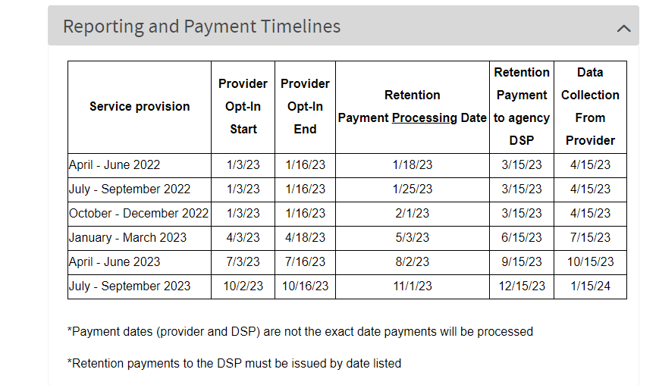
6.5% Retention Program Agency Provider Payment Schedule

Slide 10
We need your feedback
October - 2023
2024 Provider meeting Topics Survey
OPRA Leadership Training- Advance Leadership
OPRA Conferences
10

Slide 11
Upcoming Provider Training
NEW- MUI Referesher Training-
Initial Medication Certification Category 1
Initial Provider Training
Annual Provider Training
CPR/First Aid Blended Learning
Initial Medication Administration Category 2 & 3
Renewal Medication Certification Category 1, 2 & 3
Tech Go Bag Training/Lending
All classes listed above are open for registration on the Ashtabula County Board of Developmental Disabilities website under the Provider support tab. https://www.ashtabuladd.org/
Notes:
Reminders for registration- Complete applications and send them in to me. Please make sure applications are completed entirely. If you have a staff registered and they are unable to attend please make sure that you are reaching out to cancel their registration. Class sizes are limited and if staff do not show up that will take away from other staff being able to register.

Slide 12
October Community
Outreach Activities
12

Slide 13
Upcoming Activities

Slide 14
Open MIC & Questions
14

Slide 15
Thank You!
Next Provider meeting
November 9, 2023
1:00 PM-3:00 PM
Personal Funds Rule review & Benefits Analysis information
15

