Slide 1
Provider Meeting
September 12, 2024
1:00PM-3:00PM

Slide 2
DSP of the Month
Rikki Miller
Terry Gordon
Michelle Spencer

Slide 3
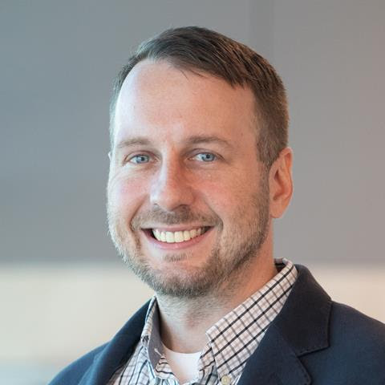
BRYAN PETKOFF, RD, LD
Manager of Healthcare Partnerships for Ohio and Michigan
Cell: 216-470-1713
Phone: 844-648-8512
Bryan.Petkoff@momsmeals.com
Ohio Case Managers | Mom's Meals (momsmeals.com)
www.momsmeals.com

Slide 4
Congratulations!
SSA Department
SSA Manager

Slide 5
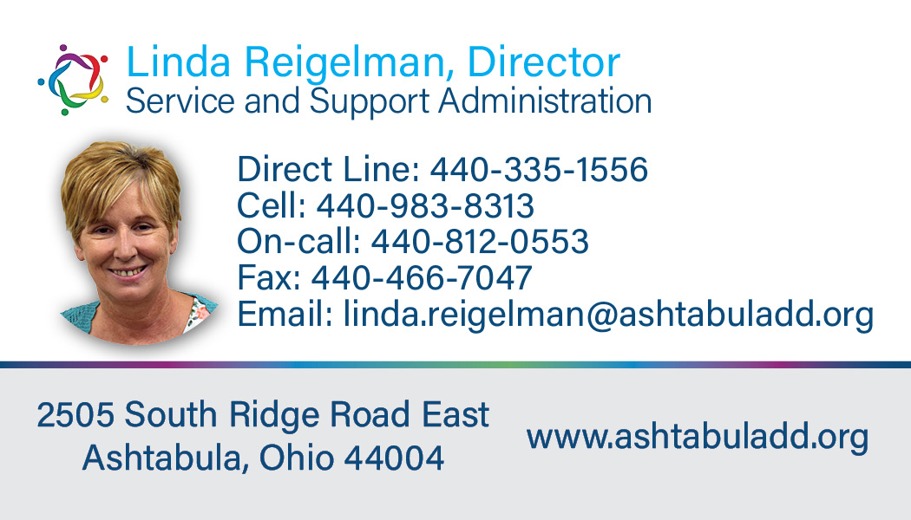
SSA Department
Please do not hesitate to reach out and talk with our new SSA director. She is looking forward to hearing from you!

Slide 6
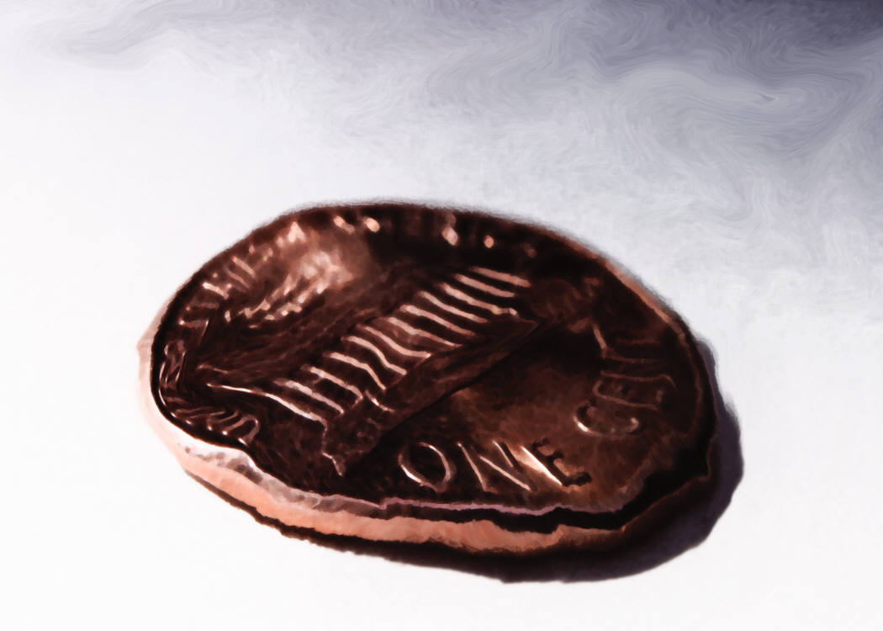
COVID-19 Update
Current variant is KP.3.1.1
Fever or Chills
Shortness of Breath of Difficulty Breathing
Congestion of Runny Nose
Fatigue New Loss of Taste or Smell
Headache Muscle or Body Aches
Cough Nausea or Vomiting
Sore Throat Diarrhea
ISS Department

Slide 7
COVID-19 Update
CDC Guidelines:
Vaccinate
If showing symptoms: Stay Home, Test
If positive,
Self quarantine
Return to normal activities 24 hours after symptoms are better overall and the person is fever-free without medications
ISS Department

Slide 8
COVID-19 Update
CDC Guidelines:
Recommend mask wearing for 5 days after resuming normal activity
Distancing from others
Improving ventilation around others
ISS Department

Slide 9
COVID-19 Update
CDC Guidelines:
If exposed to someone with COVID
Test, but not earlier than 24 hours after exposure
If negative, test again 48 hours later
If negative again, test again 48 hours after second test
ISS Department

Slide 10
COVID-19 Update
Free COVID test kits are available at:
Ashtabula County Health Dept. Ashtabula City Health Dept.
12 W. Jefferson St. 4239 Main Ave.
Jefferson Ashtabula
440-576-6010 440-992-7143
Conneaut City Health Dept. Ash. Co. Mental Health & Recovery Svcs.
327 Mill St. 4817 State Rd. Suite 203
Conneaut Ashtabula
440-593-3087 440-992-3121
ISS Department
Online at COVIDtests.gov
(coming at the end of September)

Slide 11
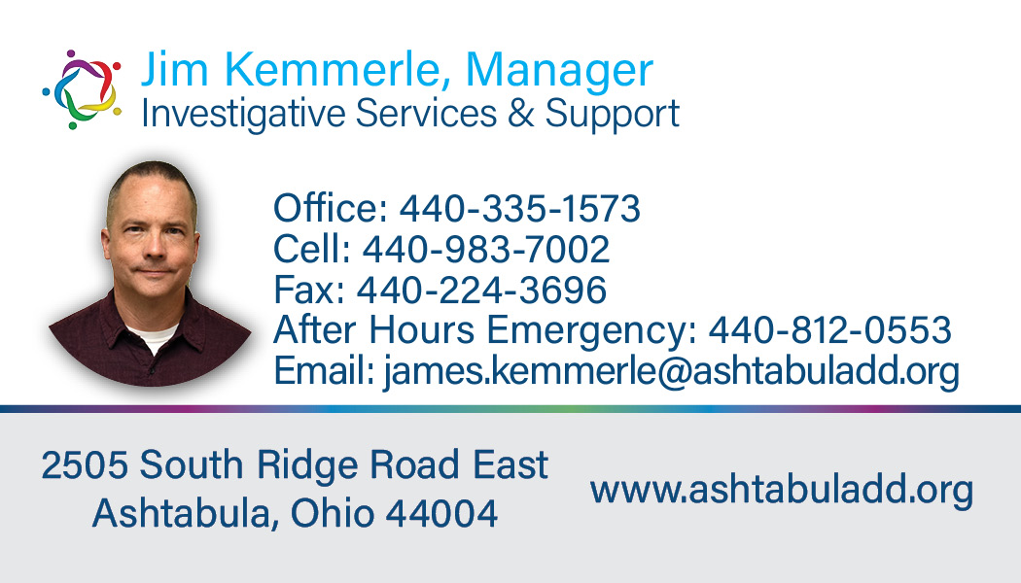
ISS Department
If you have any questions about COVID guidelines and prevention or anything related to MUI/UI’s please contact James Kemmerle.

Slide 12
QCO Department
Take a look at StationMD’s impact: https://youtu.be/Y9ssFPuR0XA
Emily Martinez, Account Executive
Phone: 908-663-2929 ext. 923
Mobile: 330-531-4879
Web: www.StationMD.com
Email: emily.martinez@stationmd.com
515 Valley Street, #203, Maplewood, NJ 07040

Slide 13
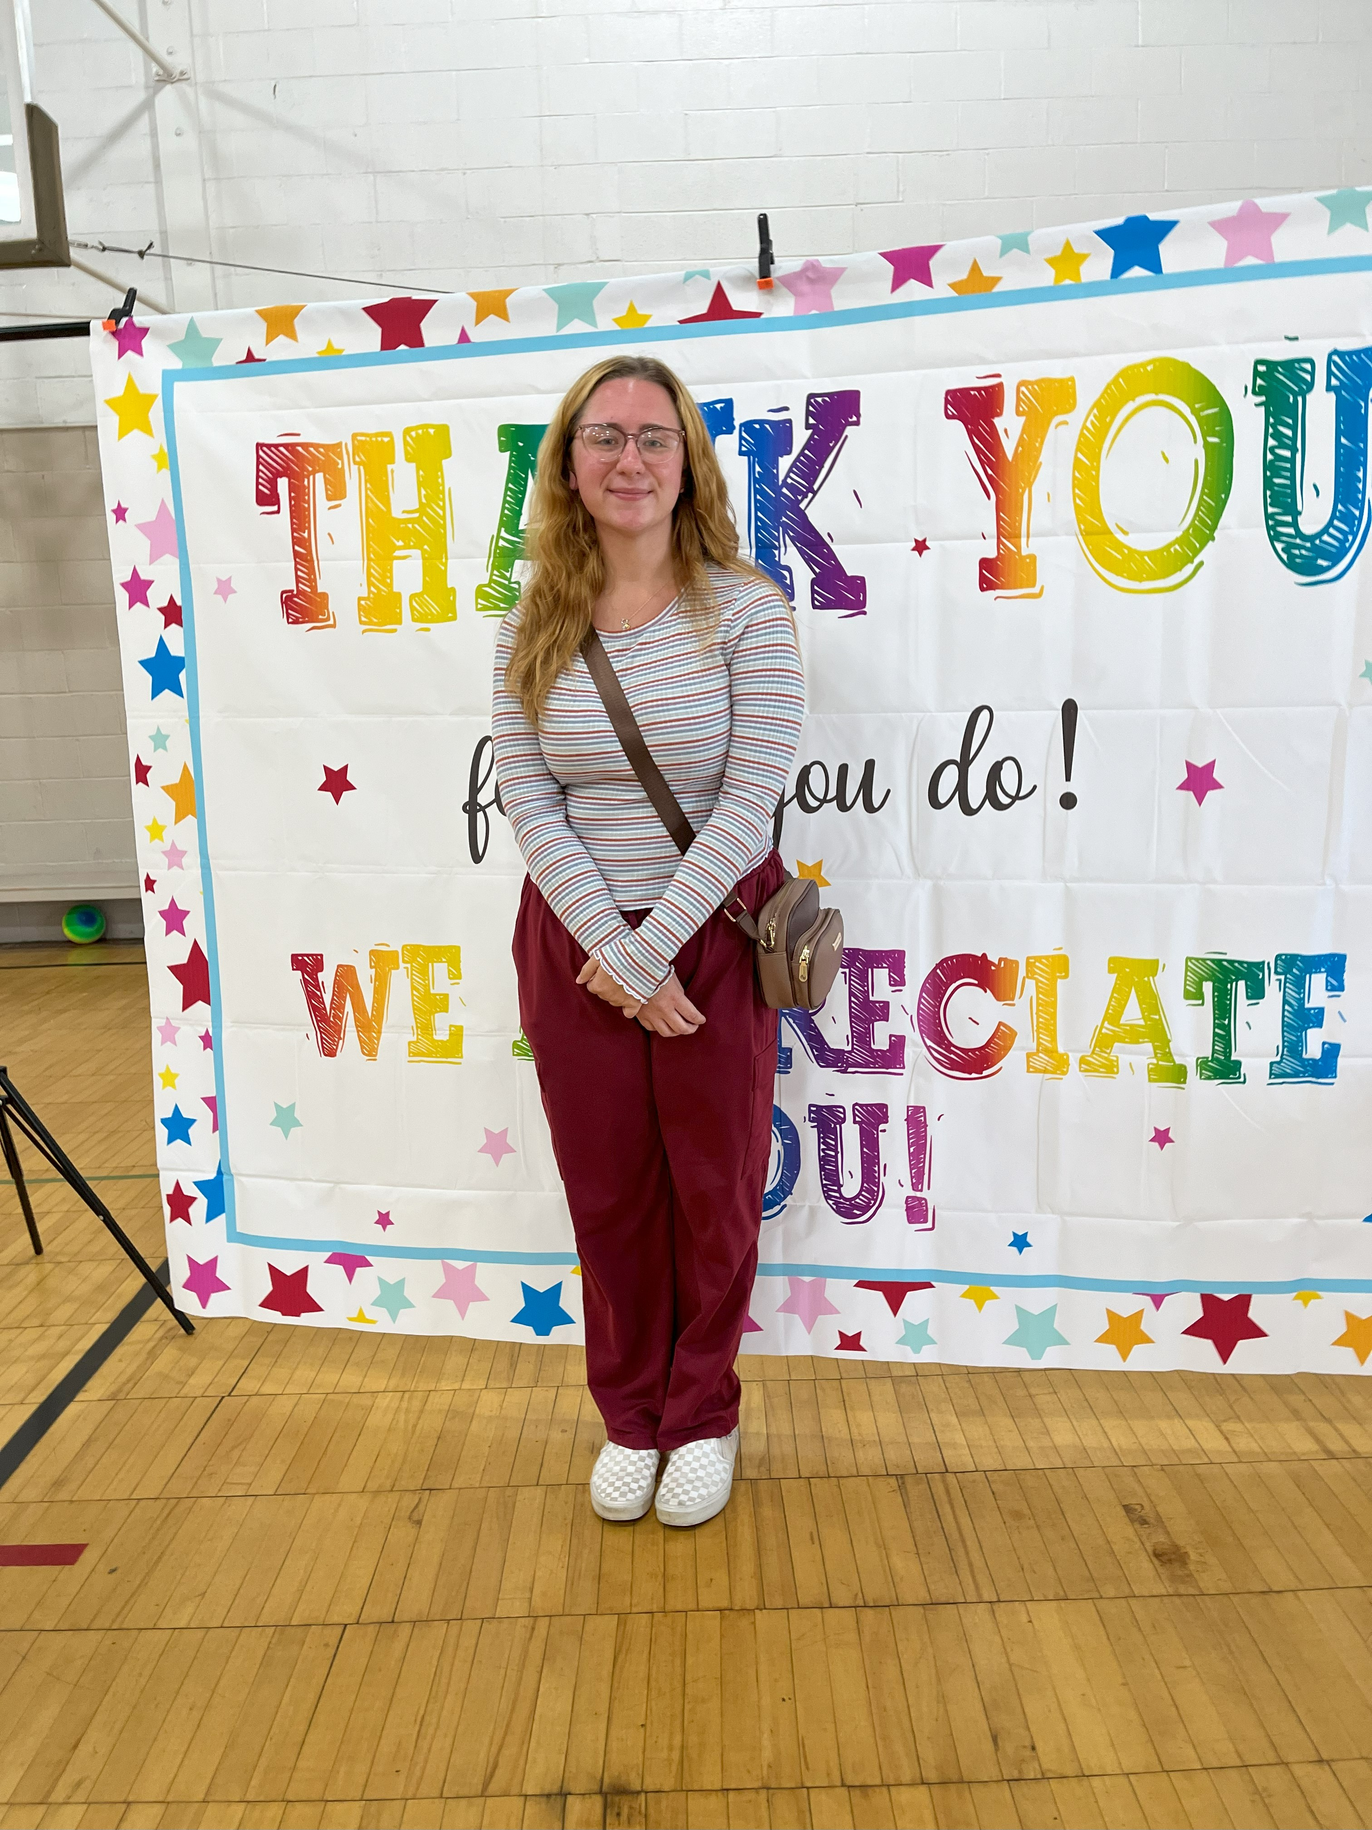
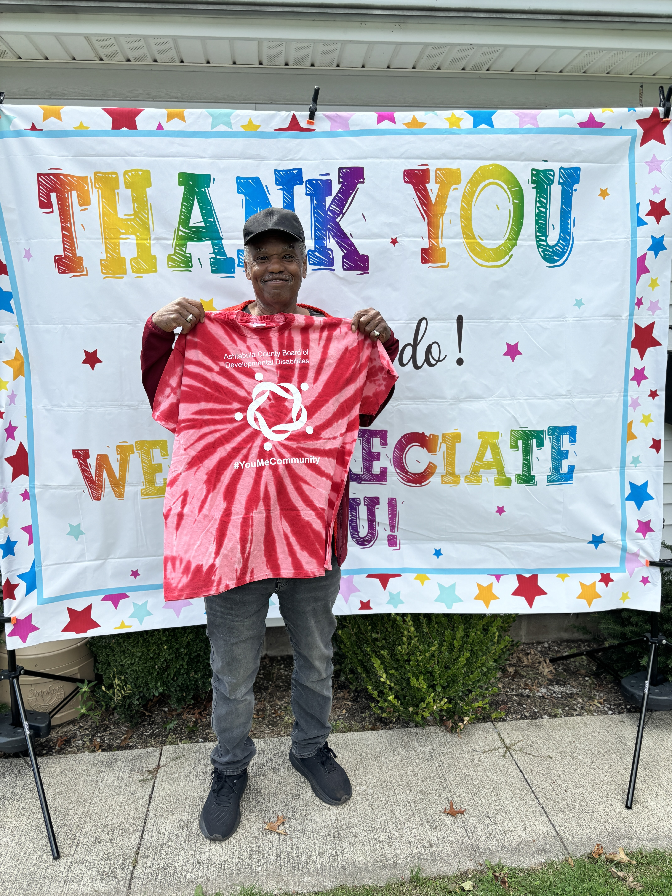
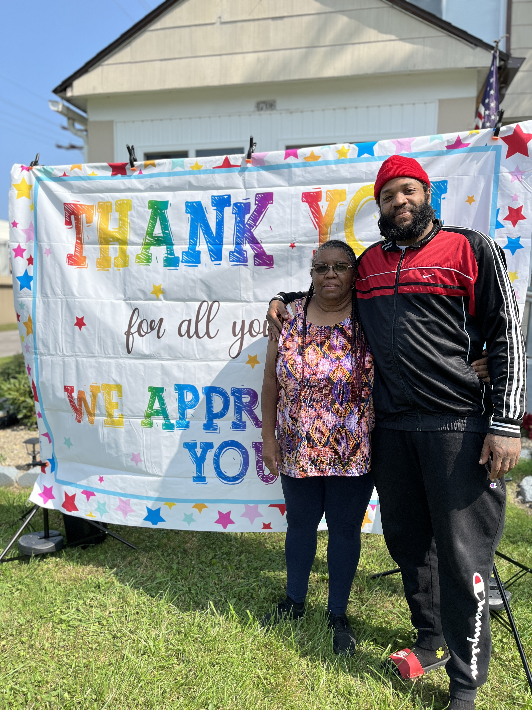
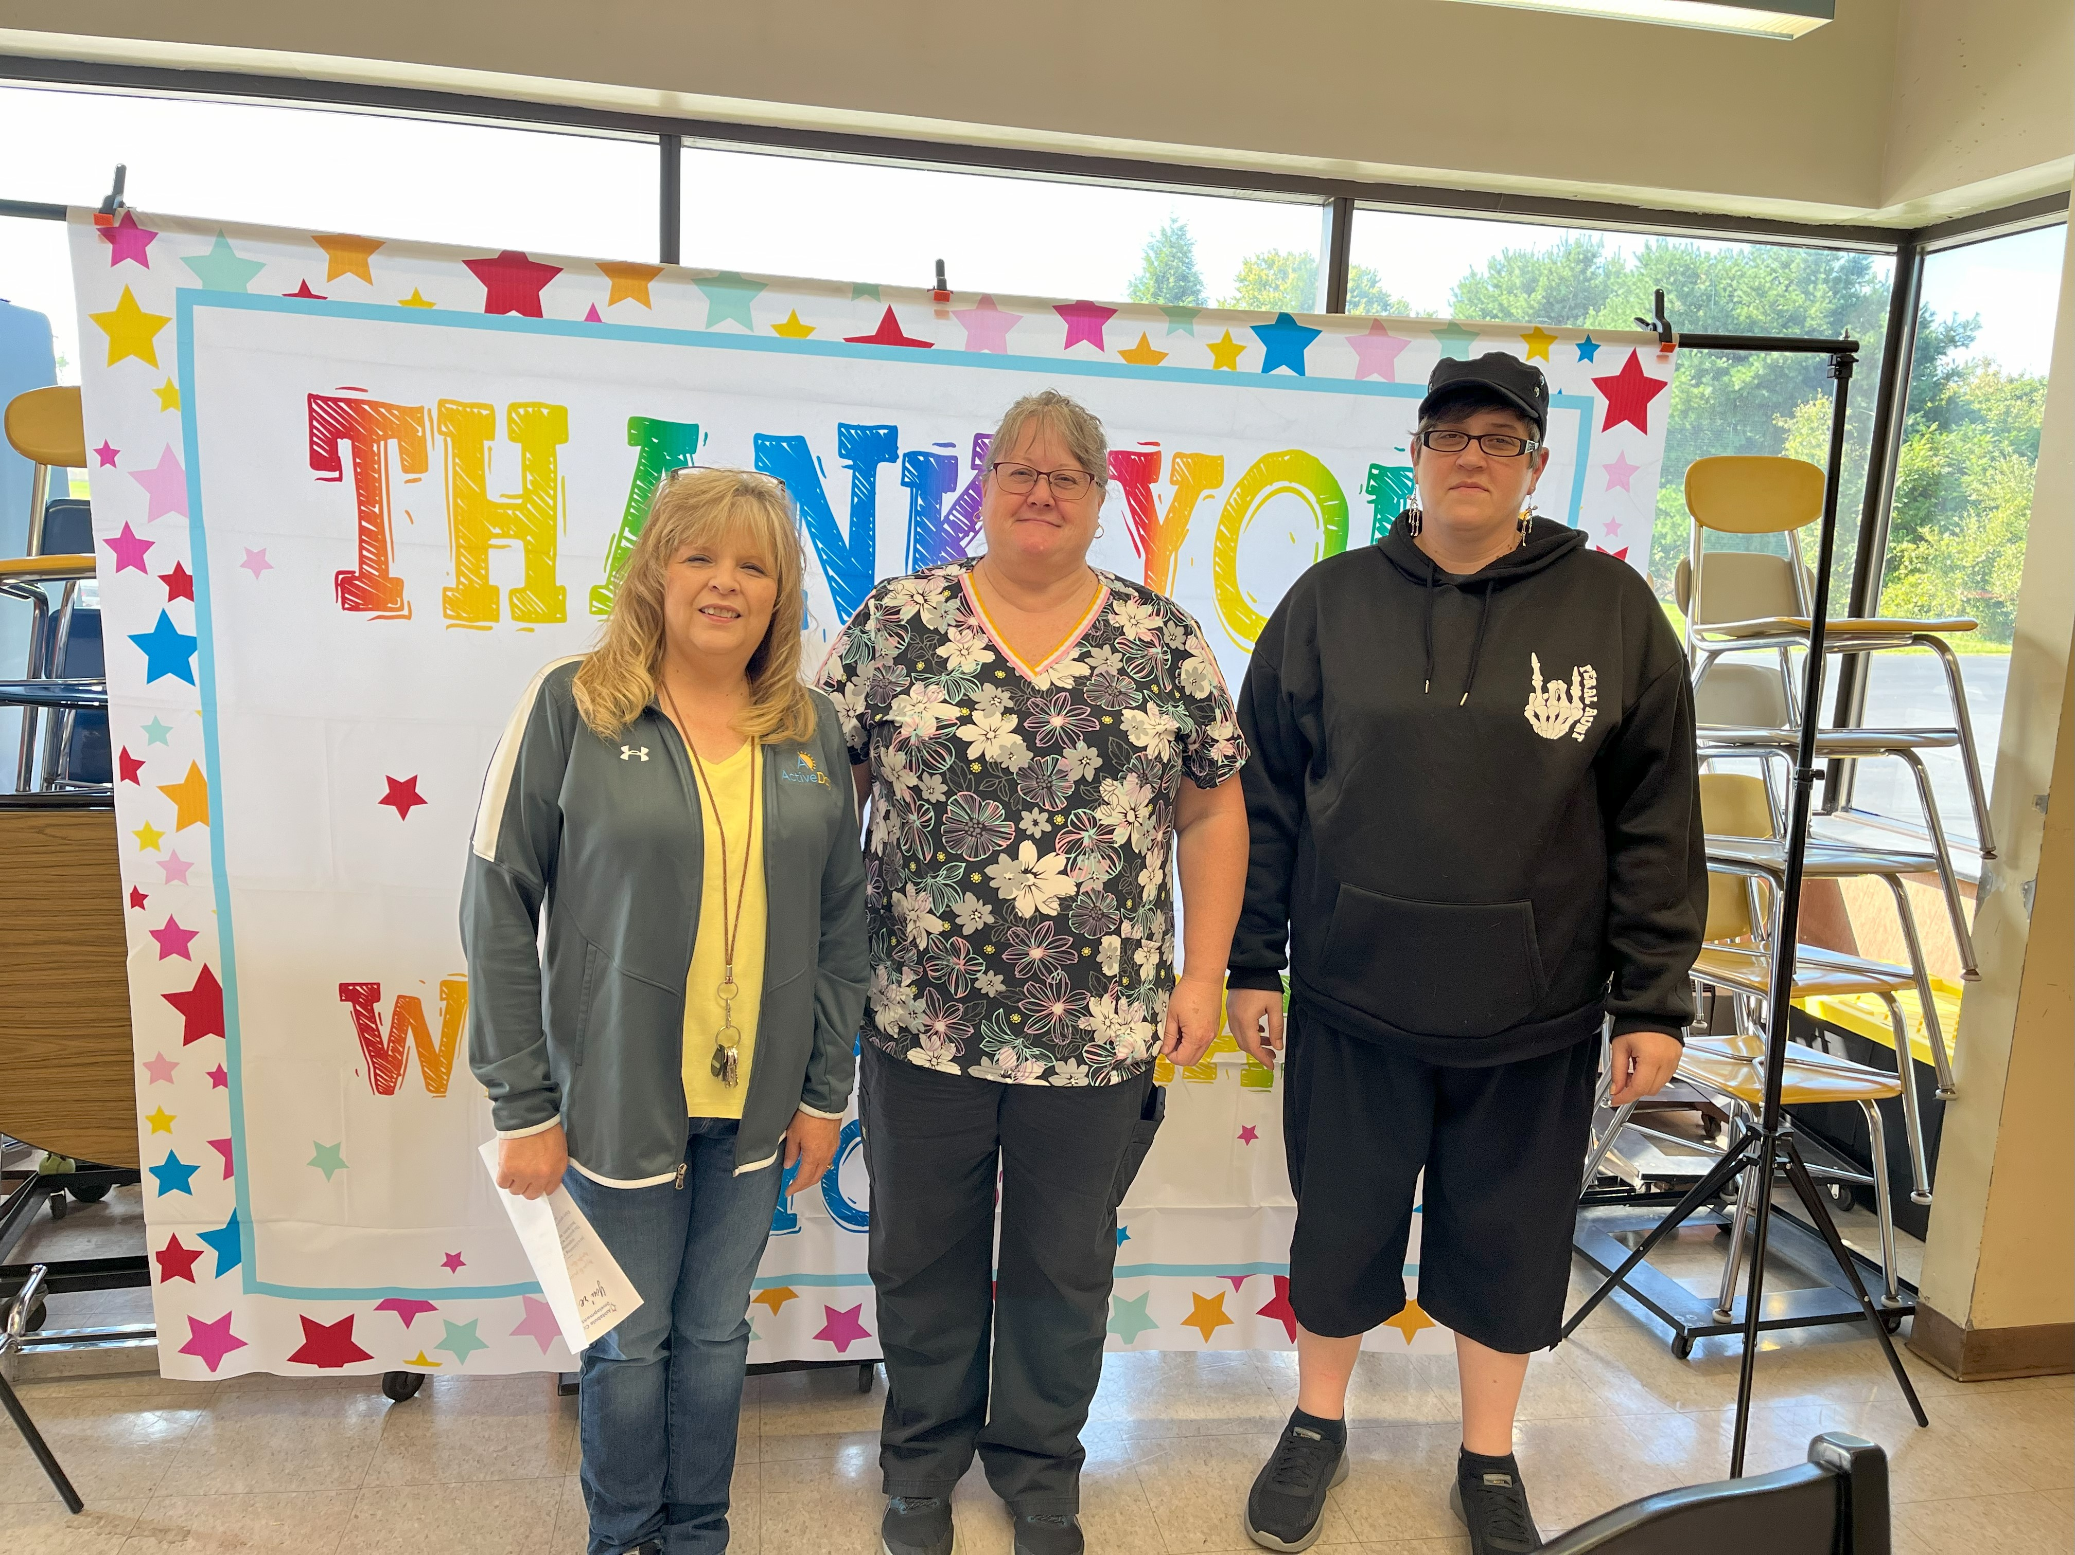
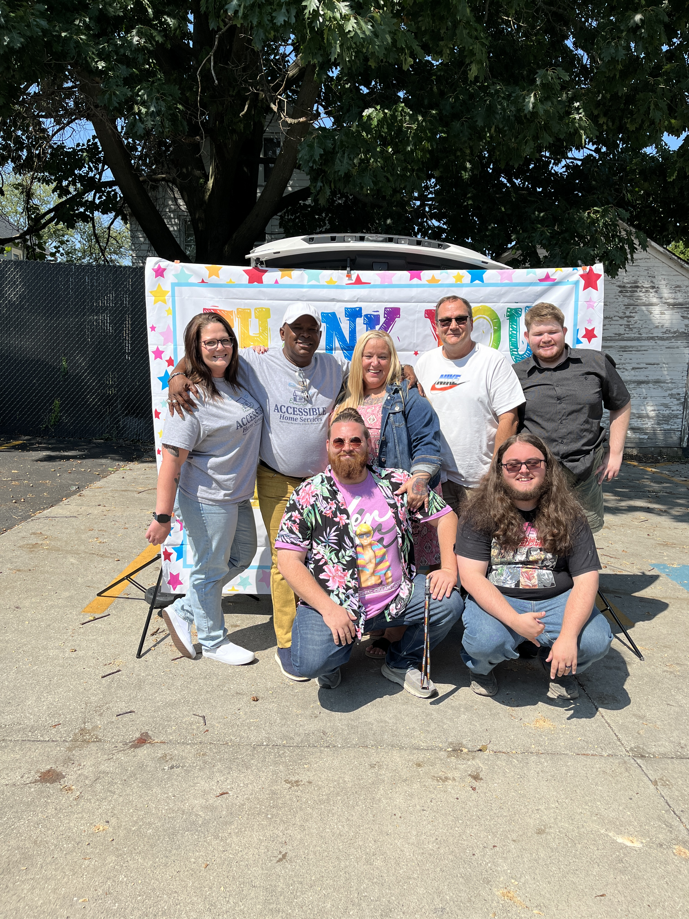
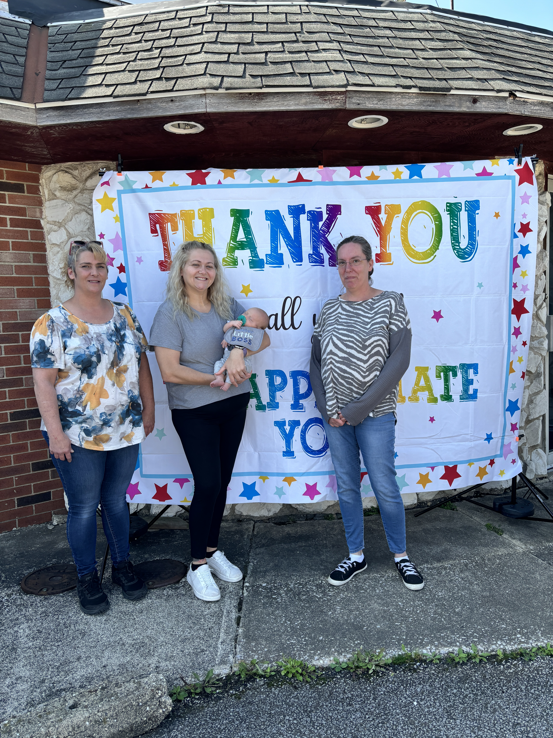
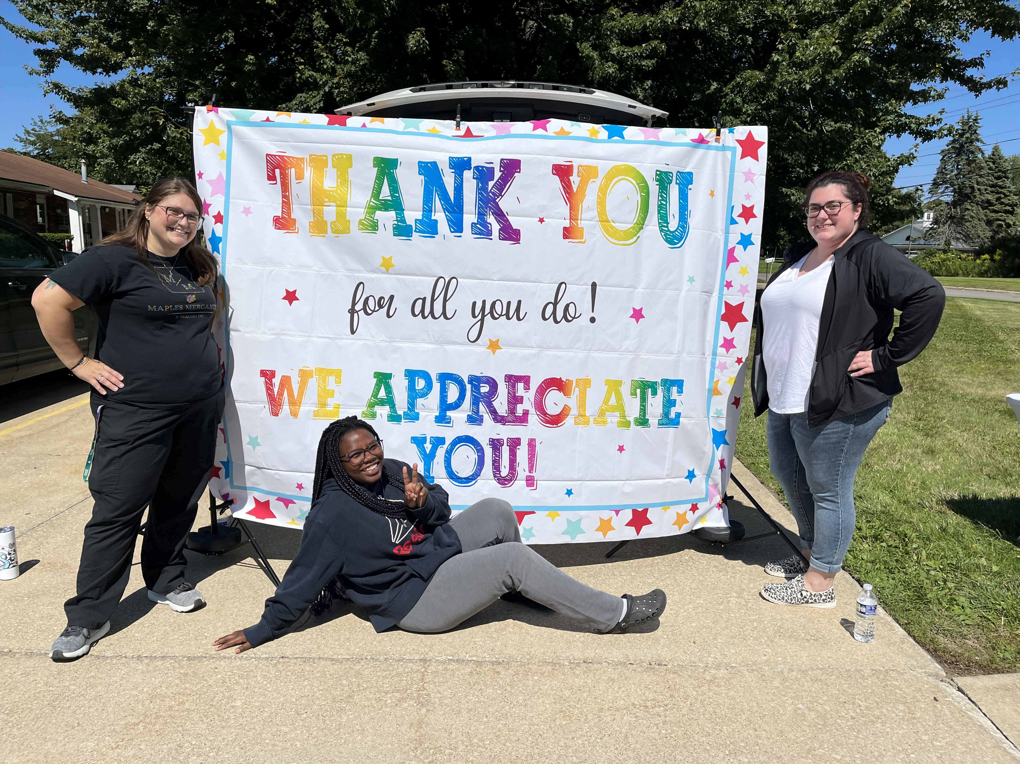
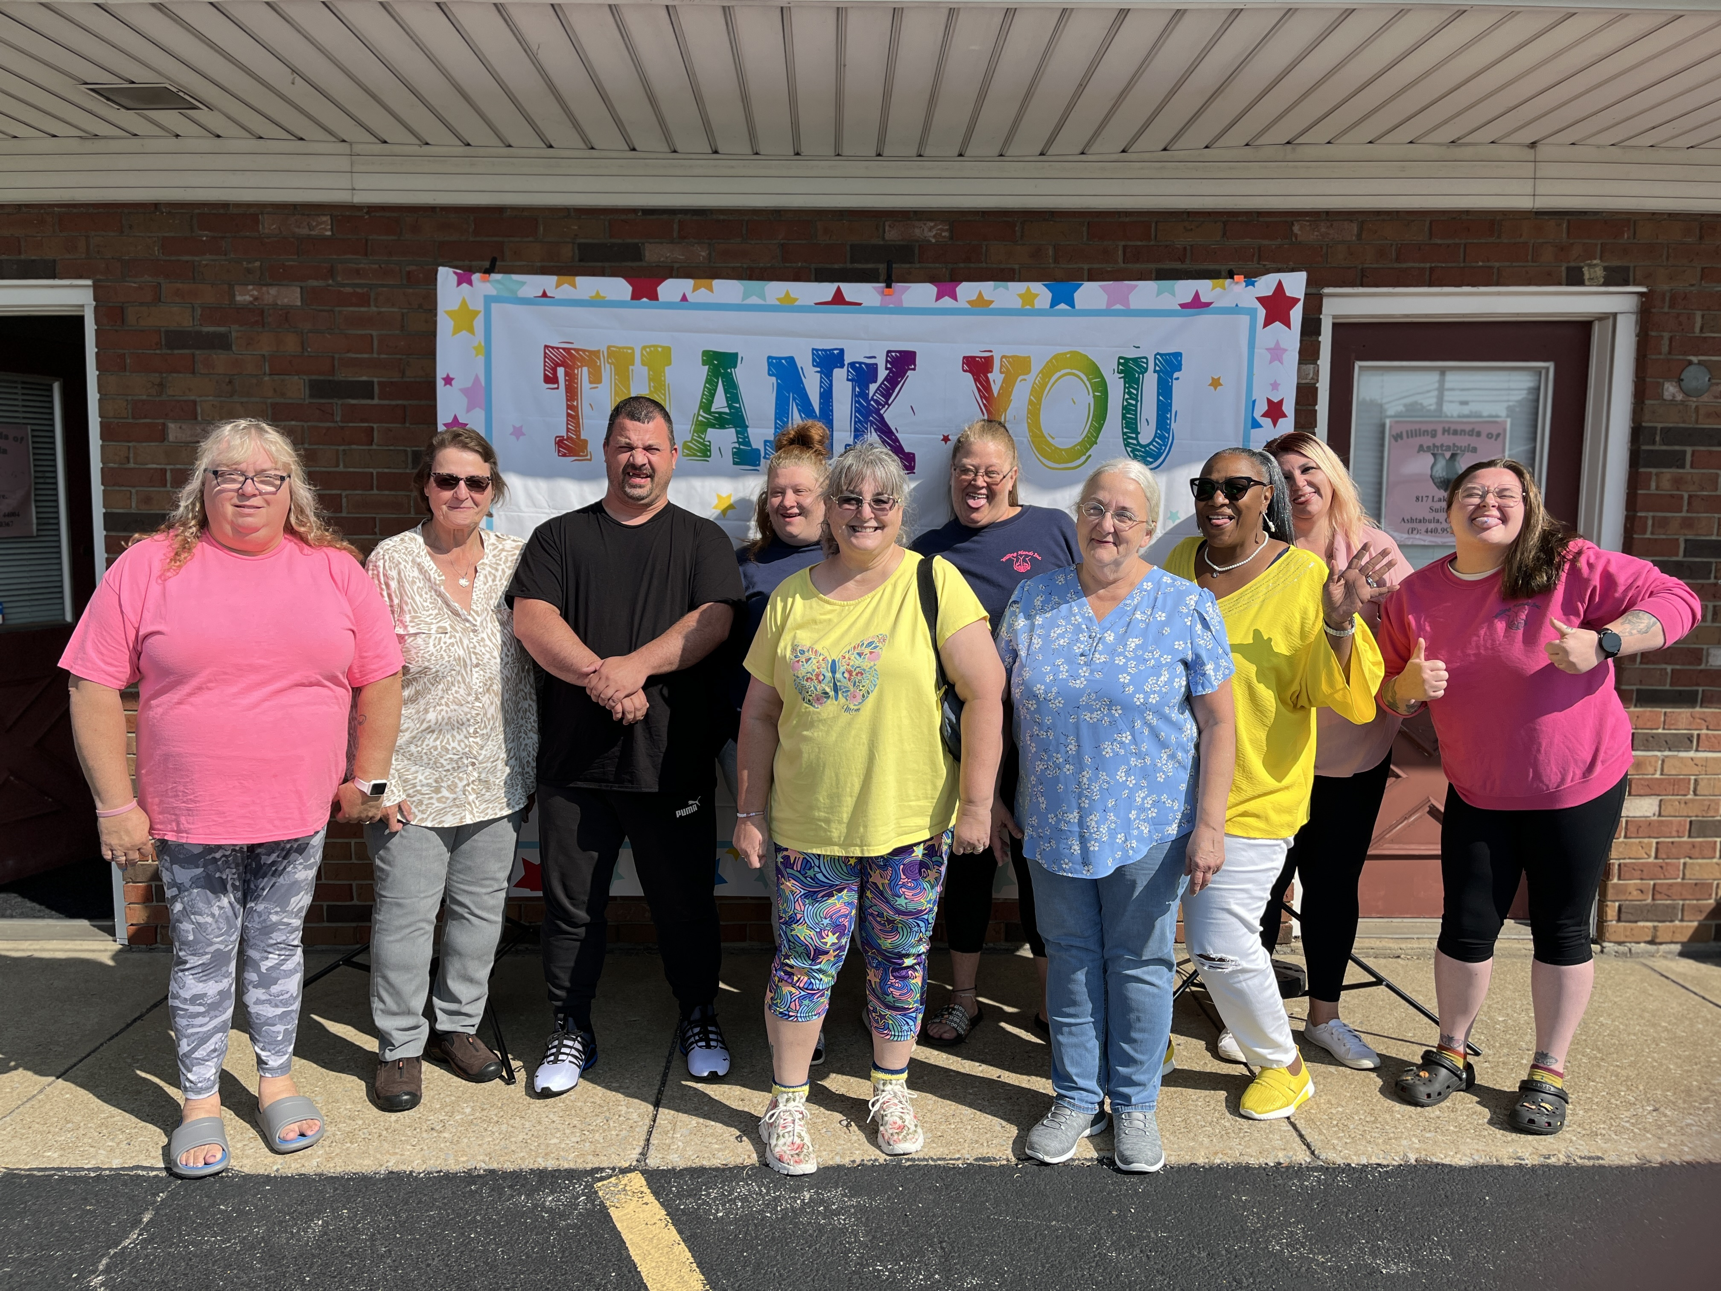
QCO Department
DSP Appreciation
September 16th- REM and Manor Home
September 17th- Viaquest and Walden Residential
September 18th- CLW 1 & 2
September 20th Richwood Residential and Grape Escape/Clearwater Homes
September 27th- Devoted Guidance, PEGI, Ellis and all Independent Providers

Slide 14
QCO Department
Honoring DSP’s of the
Month for 2024
RSVP
September 26, 2024
4:00PM-7:00PM

Slide 15
THANK YOU DSP’s
Superintendent’s Corner

Slide 16
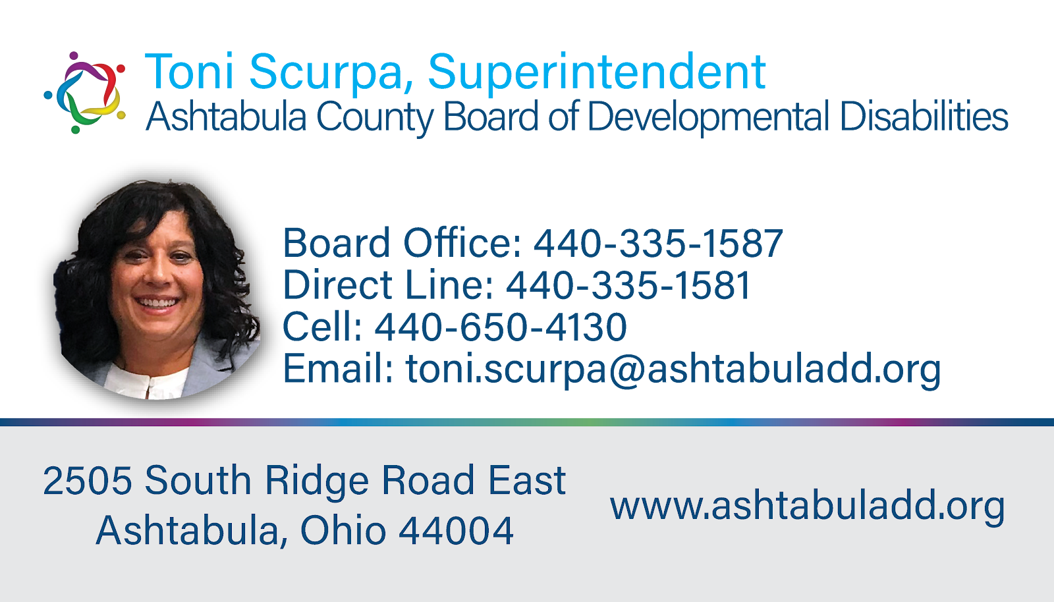
Legislative & State Updates
Superintendent’s Corner

Slide 17
Community Inclusion activities
https://wethrivetogether.org/
QCO Department
17

Slide 18
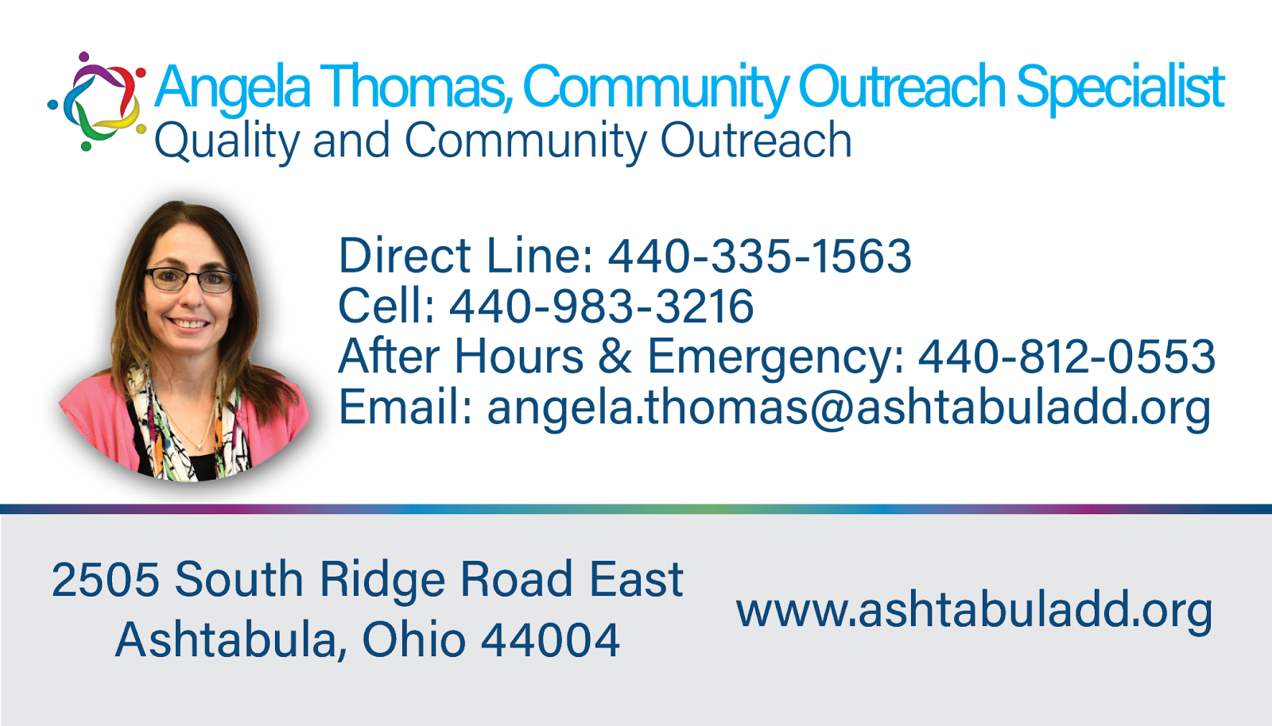
And So Much More!
QCO Department
If you have any questions about social inclusion activities do not hesitate to reach out to Manda, Angela or Haylee!

Slide 19
Upcoming Training
MUI Referesher Training- October 16, 2024
Initial Medication Certification Category 1– September 23 & 24, 2024
Initial Provider Training- October 9, 2024
Annual Provider Training- October 29, 2024
CPR/First Aid Blended Learning – October 7, 2024
Initial Medication Administration Category 2 & 3- October 21, 2024
Renewal Medication Certification Category 1, 2 & 3 – October 22, 2024
Nonviolent Crisis Intervention® (NCI™) - September 4- CANCELLED
Autism Spectrum Disorder Next Class November 4, 2024
All classes listed above are open for registration on the Ashtabula County Board of Developmental Disabilities website under the Provider support tab. https://www.ashtabuladd.org/

Slide 20
OPEN MIC

Slide 21
Thank You!
Next Provider Meeting
October 10, 2024

